Slide 1
Ch. 15
Kinetic and Potential Energy

Slide 2
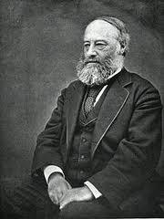
Energy
- The ability to do work (force x distance)
- measured in Joules (J)

Slide 3
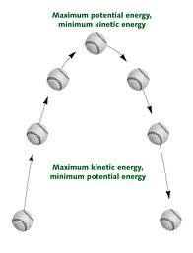
Types of Energy
Kinetic Energy (KE)
- Energy of motion
- KE= 1/2mv²
^{m = mass}
^{v = velocity}
The faster and object moves (velocity) and the heavier it is (mass) gives it more KE
Potential Energy (PE)
-stored energy due to position or shape
-position- the higher an object is = more PE
- PE = mgh
m=mass
g=gravity(9.8m/s2)
h=height
Shape- bending or stretching an object can store energy (rubber bands)

Slide 4
Types of Potential Energy
Gravitational Potential Energy - potential energy that depends upon an object’s height.
*Most common type and what we will mostly talk about!
Elastic Potential Energy - potential energy of an object that is stretched or compressed.

Slide 5
Potential Energy Problems
Find the potential energy of a light that has a mass of 13.0 kg and is 4.8 m above the ground.
2. What is the potential energy of a car that is held up on a crane 40 meters high, and has a mass of 3000. kg?

Slide 6
Kinetic Energy Problems
1. The fastest human foot speed on record was 12.42 m/s seen by Usain Bolt during a 100 meter sprint. If Usain Bolt has a mass of 94 kg what was his kinetic energy during this run?
2. What is the kinetic energy of a jogger with a mass of 65.0 kg traveling at a speed of 2.5 m/s?

Slide 7
Forms of Energy
Mechanical- moving objects (not looking at atomic level)
Thermal- movement of atoms, related to heat
Electrical- dealing with movement of electrons/electric charges
Chemical- energy trapped in bonds (gas, coal, bread, apples)
Nuclear- energy from the strong and weak force
fission- splitting an atom (power plants use U)
fusion- joining atoms (sun combining H's into He's)
Electromagnetic- spectrum found on pg 540 of book (UV, xrays, visible light, radio waves)

Slide 8
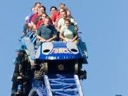
Mechanical Energy
(KE + PE)initial = (KE + PE)final
- A diver on the board has no velocity ( so their initial KE is 0), but they have lots of height (so their initial PE is very high)
Just before they hit the water their velocity is very high (so the final KE is high), and their height is almost 0m (so their final PE is almost 0)
PE at the initial is converted to KE at the final
PE initial = KE final

Slide 9
Kinetic vs. Potential
https://www.youtube.com/watch?v=-dpBVtAbKJU
https://www.youtube.com/watch?v=Ehx1P4adv6I

Slide 10
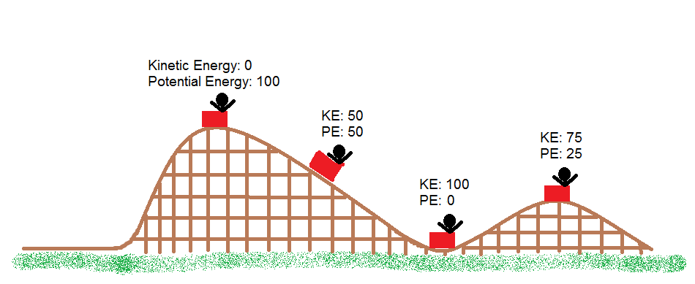
Kinetic vs. Potential in Roller Coasters

Slide 11
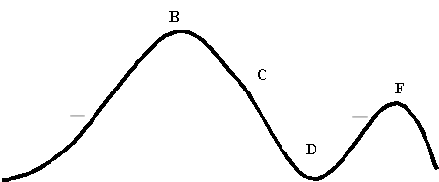
Label each letter in Graph 2 with...
KE & PE with these numbers…
10,5, & 0 J

Slide 12
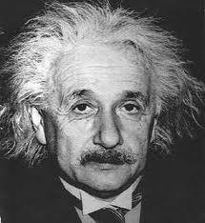
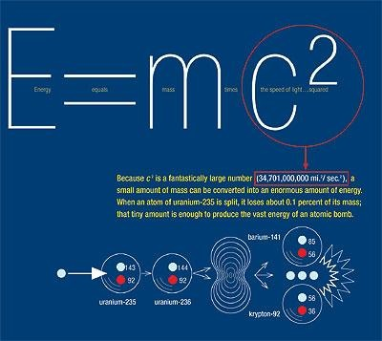
Energy and Mass
- energy and mass are basically different forms of the same thing and can be converted into one another.
-Einstein made this famous with
E = m c²
Energy=Mass x (speed of light)²
* a little bit of mass can turn into
massive amounts of energy.

Slide 13
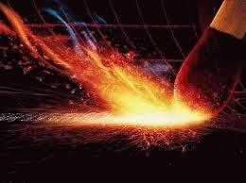
Energy Conversions
Energy can be converted from one form to another
Striking a Match --> Match Lighting --> Heating the Air
Mechanical Energy--> Chemical Energy--> Thermal Energy
Law of Conservation of Energy- Energy can not be created or destroyed, only transferred from one form to another.

Slide 14
Energy Resources
How we get our energy
Renewable Energy- energy that can be replaced in a relatively short period of time.
Nonrenewable Energy- generally fossil fuels, can not be replenished at the rate that we are using them.

Slide 15
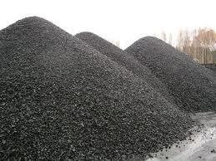
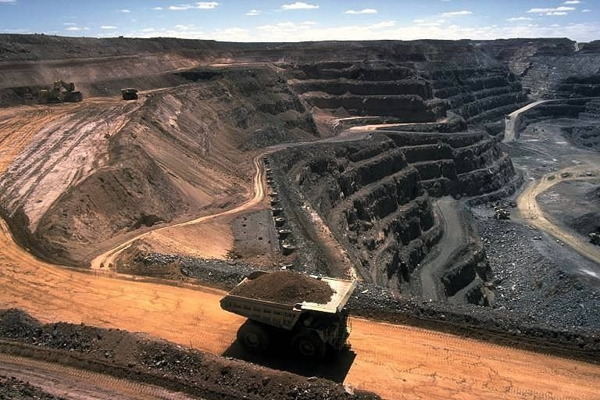
Coal
Pros
Cheap
We can get it in the U.S.
How we get most of our electricity in MI
Cons
Dirty/pollution
Mining is tough on environment
Nonrenewable

Slide 16
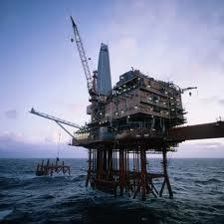
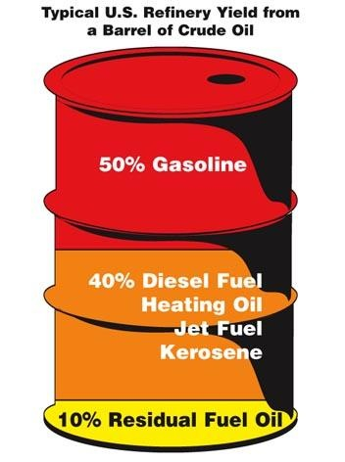
Oil
Pros
Provide very high energy for the price and mass
Cons
Dirty/polluting
Nonrenewable
Not enough in this country to sustain our needs

Slide 17
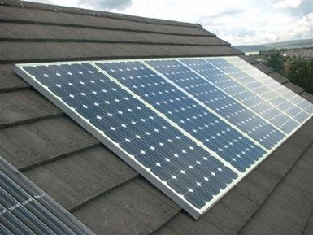
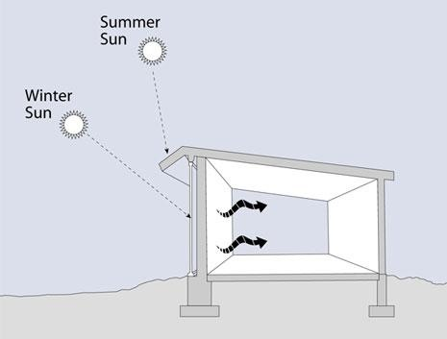
Solar
Active/Solar Panels
Cons
Only works when the sun is out
Not efficient
Doesn’t give as much energy as Fossil Fuels
Pros
Clean/Renewable
Passive-Water heating on roof, South facing homes, etc.
Pros
Simple and easy
Cheap
Renewable
Cons
Won’t cover all needs
Only acts as a supplement

Slide 18
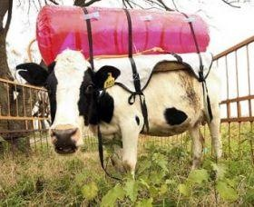
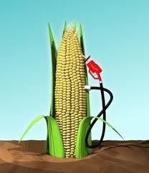
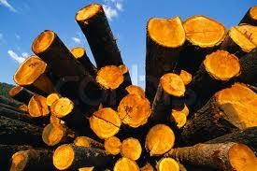
Biomass-using the chemical energy stored in living things
Pros - energy can be produced locally
Ex- burning wood, collecting methane from cow manure, ethanol from corn
Cons
Takes more energy to make energy

Slide 19
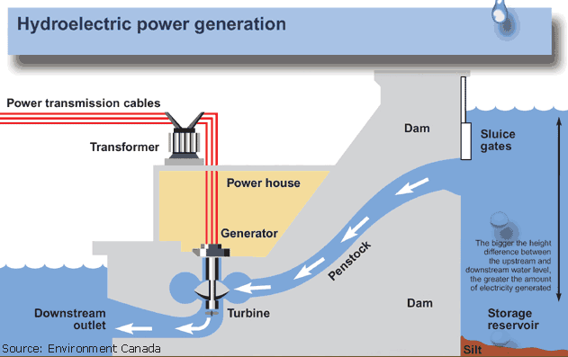
Hydroelectric-using dams to force water to turn a turbine to make electricity
Pros
Renewable
Clean, no fossil fuels
Cons
Changes river ecology- fish, plants, people

Slide 20
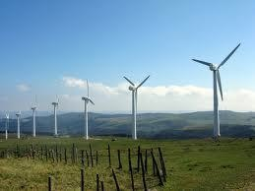
Wind
Pros
Renewable
Clean energy
Cons
High cost low yield
Only works in windy areas
Noisy/birds

Slide 21
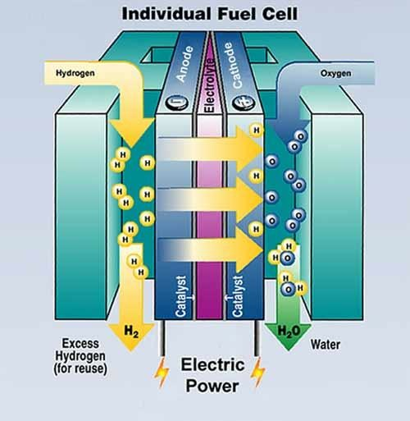
Hydrogen Fuel Cells
Pros
Renewable
Water is the waste product
Fuel is Hydrogen, which is found everywhere
Cons
Not efficient
Still science fiction

Slide 22
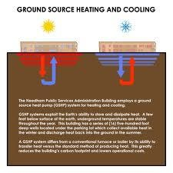
Geothermal
Magma driven- using the heat from magma to boil water, make steam, run turbines for electricity
Only works in areas near surface magma
Non-magma- stealing the heat from regular ground water, to heat buildings

Slide 23
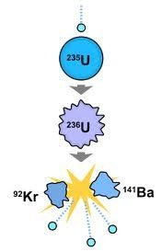
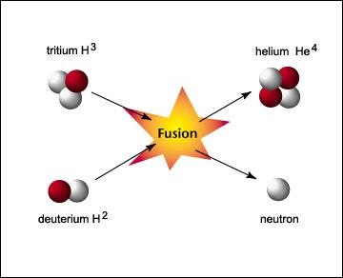
Nuclear
Fusion-combining hydrogen atoms to make energy (how our sun works)
Cons
Not efficient
Still science fiction with efficiency
Fission-Splitting Uranium atoms, capturing the heat to boil water and make electricity
Pros
High energy for only a little fuel
Cons
Dangerous
Radioactive waste

