Slide 1
Chapter 16 Notes
Heat

Slide 2
Heat
Transfer of thermal energy from one object to another because of the difference in temperature.
Heat energy is measured in Joules (J).

Slide 3
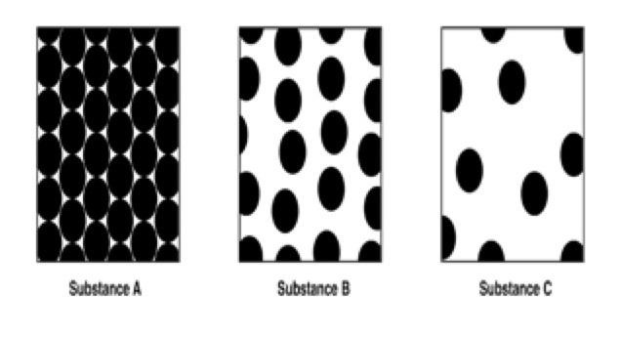
Review of types of matter
Substance A: Solid
Substance B: Liquid
Substance C: Gas
Which substance will conduct heat the best?
SOLIDS!!!
Why?
Because the atoms are closer together

Slide 4
Heat Conduction
What type of solid conducts heat better? Circle One
Wood
Ice
Iron

Slide 5
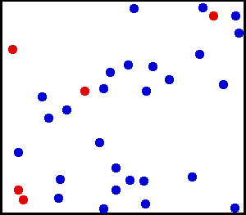
Temperature
-Temperature = Average kinetic energy of the particles
faster moving = hotter
slower moving = colder

Slide 6
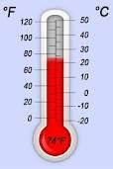
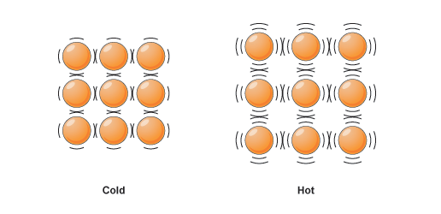
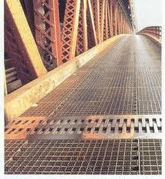
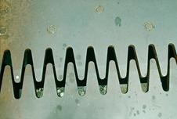
Thermal Contraction/Expansion
Therm
As molecules get hotter, they move faster and expand. (thermal expansion)
As molecules get colder, they move slower and contract.
(thermal contraction)
Except for when water goes from a liquid to a solid

Slide 7
Specific Heat
-Amount of heat needed to raise the temp. of one gram of a material by one ℃
- Measured in J/g℃
-Lower Specific Heats --> take less energy to heat up.
ex. metals
-Higher Specific Heats --> take more energy to heat up.
ex. water, styrofoam

Slide 8
Heat Formula
Q = m x c x t
Q = Heat energy (Joules)
m = mass (grams)
c = specific heat (J/gC)
t= change in temperature (Celsius)
m = Q/(c x t) c=Q/(m x t) t=Q/(m x c)

Slide 9
Example 1:
How much heat does a 6 gram piece of aluminum lose if it goes from 16℃ to -32℃? The specific heat of aluminum is .89 4.18 J/g℃

Slide 10
Example 2
What is the change in temperature that must have taken place if 10 grams of water lost 376.2 Joules? The specific heat of water is 4.18 J/g℃

Slide 11
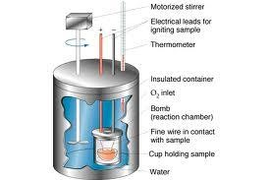
Calorimeter
- Measures changes in heat
Heat lost by one thing = heat gained by another (until equilibrium)

Slide 12
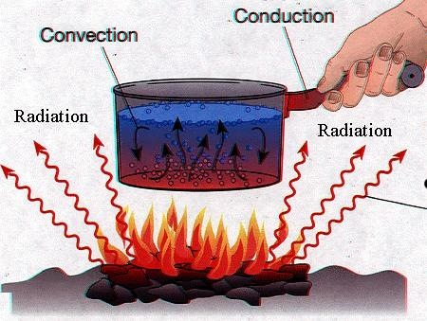
Heat Transfer
Conduction- heat transfer through direct contact (matter is needed to transfer the heat)
Convection- heat transfer through the movement of fluids (liquids or gasses) (matter is need to transfer the heat)
Radiation- heat transfer through electromagnetic waves of radiation (matter is not needed for heat transfer in this case)

