Slide 1
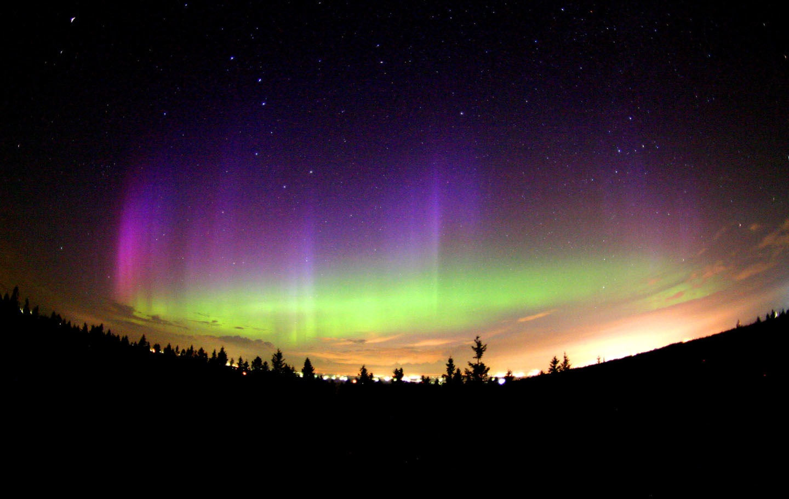
Electricity

Slide 2
Electric Charge
Electric Charge Rules:
More protons than electrons: + charge
More electrons than protons: - charge
So if an atom gains an electron, it becomes a negatively charged ion
Like charges repel; opposite charges attract
Causes the flow
In electricity, ONLY e- move, not protons!
Strength of electric force due to
Quantity of charge involved
How far apart the charges are

Slide 3
Electric Field
Electric Field: region around charged particles in which others will attract or repel
Note: Strength of the field depends on
amount of charge produced
distance from charge

Slide 4
Static Electricity and Charging
Charge can be transferred by friction, contact, and by induction
Friction
Ex
rubbing a balloon against your hair
walking across a carpet
Contact
Ex - Touching a Van de Graff generator
Induction - when charge is transferred without contact
A neutral metal comb becomes charged by being held near a charged object

Slide 5
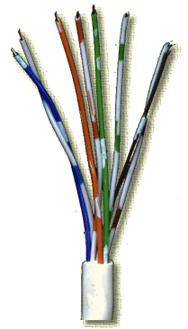
Flow of Electricity
Electric Current: flow of e- through a wire
Symbol for current is I
Current is measured in amperes, or amps (A) for short
 current =  e-

Slide 6
Resistance: opposition to flow of electricity
Symbol for resistance is R
Resistance is measure in ohms, which is represented by Ω
Poor conductors have high resistance (or low conductivity)
Ex. Iron
Good conductors have low resistance (or high conductivity)
Ex. Copper
Long and thin wires have more resistance than short and thick wires
Resistance is affected by a material’s thickness, length and temperature
Any device that you plug in is called a resistor (load)
Notes:
Increase in temp leads to increase in resistance
Increase length leads to increase in resistance
Decrease in thickness leads to increase in resistance

Slide 7
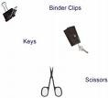
Flow of Electricity
Conductors & Insulators
Conductor – material charge can flow through easily
Ex – metal such as copper and silver
Insulator – material charge can not flow through easily
Due to electrons being tightly bound to its atoms
Ex. – wood, plastic, rubber, air, glass

Slide 8
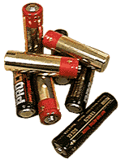
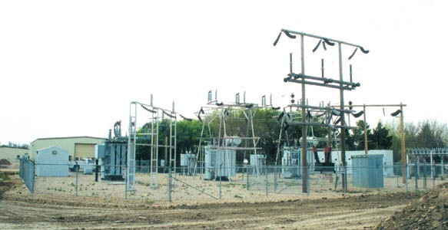
Flow of Electricity cont.,
Ohm’s Law:
current in a wire =voltage/resistance (I=V/R)
Current Directions:
Direct Current (DC): electrons flow in the same direction
Ex. Batteries (e- flow through and terminal)
Alternating Current (AC): Electrons constantly change their direction of flow
Ex. Electricity from power plants (via generators); therefore the electricity in your home and school is mostly alternating current.
The electricity from power lines needs to go through a step-down transformer before it can be used by your home
Power (P) = voltage (V) X current (I)
(watts = volts X amps)

Slide 9
Flow of Electricity cont.,
https://www.youtube.com/watch?v=FIlFcoPAwdM

Slide 10
Electric Currents
What’s a Circuit?
Provides a complete, closed path for an electric current to flow
Circuit works when path is closed; doesn’t work when path is open
Parts of a Circuit:
A source of e- (i.e. battery, outlet)
A load (resistance) which is the device that uses the electricity
Wires carry the electrons
A switch, which opens or closes the circuit

Slide 11
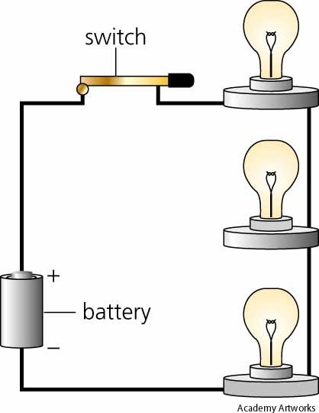
Series Circuit
Only one path for a current to flow
All parts of the circuit are connected one after the other
Ex. Old Christmas Lights
Same current (I) passes through each resistor
Current stays the same
Voltage drops after each resistor

Slide 12
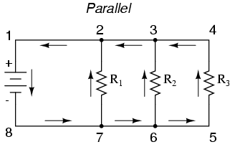
Parallel Circuit
Different parts of circuit are on separate branches
Several paths for electrons can be taken
Ex. New Christmas Lights
Ex. Circuits in your home
Voltage stays the same
Current decreases through each branch

Slide 13
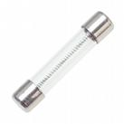
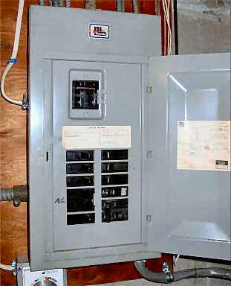
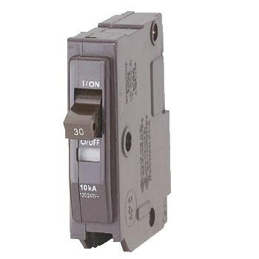
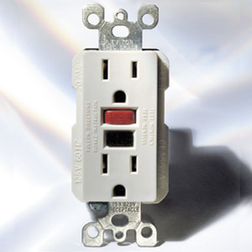
Electrical Safety
Fuse
Wire in the center of the fuse melts when too much current passes through it
Circuit Breaker
A switch opens when the current is too high
Ground-fault circuit interrupter (GFCI)
Monitors current flowing to and from an outlet or appliance
If current is not equal →current is escaping and the GFCI opens the circuit to prevent serious electric shock

Slide 14
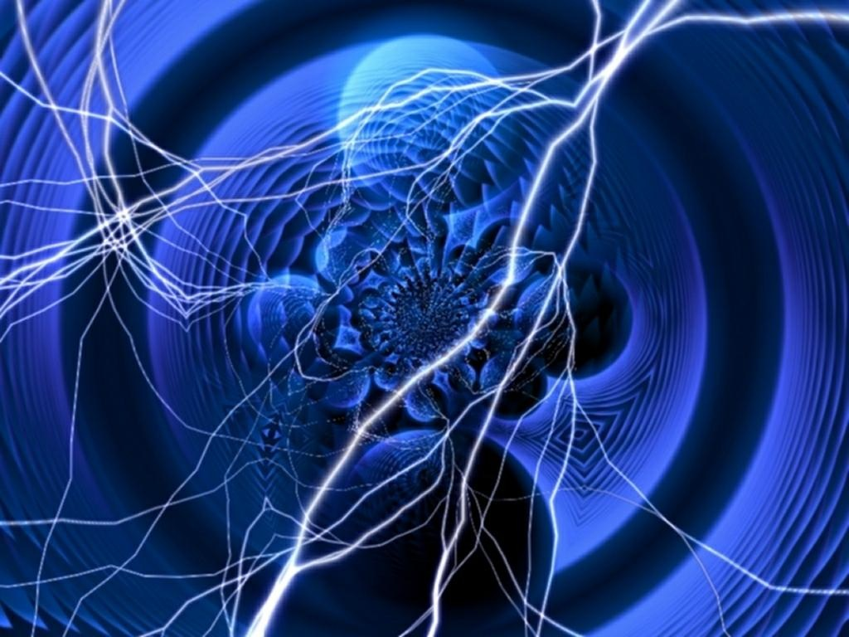
Magnetism

Slide 15
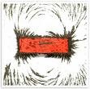
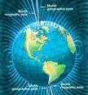
Magnetism
All magnets have North and South poles
If you break a bar magnet in half, each half will become a bar magnet with two poles
Rule for magnetic poles: like poles repel/opposites attract
Magnetic Field = region in which magnetic forces can act
Earth has one around it (Magnetosphere); strongest at poles
Magnetic lines of force define these areas
Electrons in atoms spin, causing the magnetic field
Magnetic Force – as two magnets move farther apart, the magnetic force ↓

Slide 16
Electromagnetism
Electricity and magnetism are inseparable
Electromagnet: made by winding wire around an iron core
Will have N and S poles
Polarity of magnet depends on polarity of electric current
Magnetism can induce electricity
Electricity can induce magnetism

Slide 17
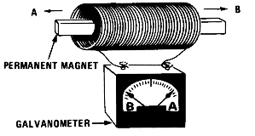
Electromagnets
Electric Wire wrapped around an iron core
These are temporary magnets; can be turned on and off
Ex. Doorbells, telephones, electric motors
Moving a magnet inside a coil of wire will induce a voltage in the coil
The faster the magnet moves → the higher the voltage

Slide 18
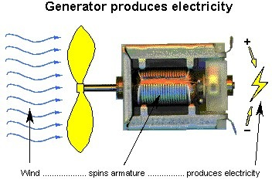
Electric Generator
Changes mechanical energy into electrical energy
Loop of wire (conductor) spins inside a magnetic field to create electricity; known as an electromagnetic induction
Most of the power you use everyday comes from generators
Burning of fossil fuels creates steam that spins a turbine which will turn the coils in a generator
In Michigan, the major source of fossil fuel is coal

