Slide 1
Electric Charge
Electric Charge Rules:
More protons than electrons: ________________
More electrons than protons: ________________
So if an atom gains an electron, it becomes a ___________ ___________ __________
Like charges __________; opposite charges ___________
Causes the flow
In electricity, ONLY e- move, not protons!
Strength of electric force due to
________________ of charge involved
How _______ _________the charges are

Slide 2
Electric Field
____________ _________: region around charged particles in which others will attract or repel
Note: Strength of the field depends on
______________ ___ __________ produced
______________ from charge

Slide 3
Static Electricity and Charging
Charge can be transferred by ____________, ___________ & _______________
Friction
Ex
rubbing a balloon against your hair
__________ ____________ ___ ______________
Contact
Ex - Touching a ________ ____ __________ generator
Induction - when charge is transferred _______________ contact
A neutral metal comb becomes charged by being held near a charged object

Slide 4
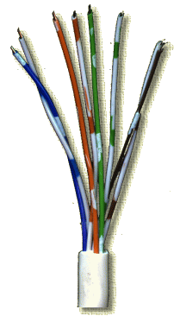
Flow of Electricity
____________ ____________: flow of e⁻ through a wire
Symbol for current is ___
Current is measured in ____________, or ____________ for short
 current =  e-

Slide 5
______________: opposition to flow of electricity
Symbol for resistance is R
Resistance is measure in _________, which is represented by _____
_________ conductors have ___________ resistance (or low conductivity)
Ex. Iron
_________ conductors have _______ resistance (or high conductivity)
Ex. Copper
Long and thin wires have more resistance than short and thick wires
Resistance is affected by a material’s thickness, length and temperature
Any device that you plug in is called a ___________ (load)
Notes:
Increase in temp leads to increase in resistance
Increase length leads to increase in resistance
Decrease in thickness leads to increase in resistance

Slide 6
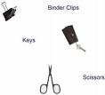
Flow of Electricity
Conductors & Insulators
_______________ – material charge can flow through easily
Ex – metal such as copper & silver
_______________ – material charge can not flow through easily
Due to electrons being tightly bound to its atoms
Ex. – wood, plastic, rubber, air, glass

Slide 7
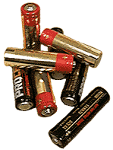
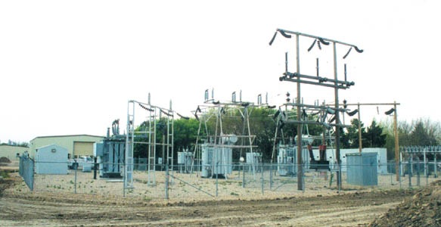
Flow of Electricity cont.,
_________ ________:
current in a wire =voltage/resistance (________)
Current Directions:
Direct Current (____): electrons flow in the same direction
Ex. Batteries (e- flow through and terminal)
Alternating Current (____): Electrons constantly change their direction of flow
Ex. Electricity from power plants (via generators); therefore the electricity in your home and school is mostly alternating current.
The electricity from power lines needs to go through a _________ _________ ___________ before it can be used by your home
Power __ = _______ X ________
(______ = ______ X _________)

Slide 8
Electric Currents
What’s a Circuit?
Provides a __________, ________ _______ for an electric current to flow
Circuit works when path is _________; doesn’t work when path is ___________
Parts of a Circuit:
A ___________ of e⁻ (i.e. battery, outlet)
A ________ (resistance) which is the device that uses the electricity
___________ carry the electrons
A __________, which opens or closes the circuit

Slide 9
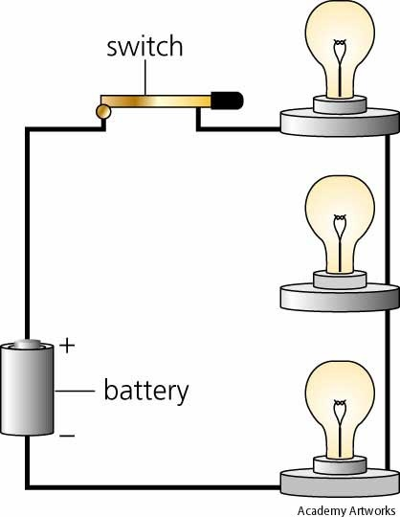
Series Circuit
Only ______ path for a current to flow
All parts of the circuit are connected one after the other
Ex. Old Christmas Lights
Same ___________ (I) passes through each resistor
Current stays the same
Voltage _________ after each resistor

Slide 10
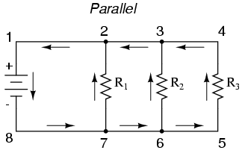
Parallel Circuit
Different parts of circuit are on ______________ branches
Several ________ for electrons can be taken
Ex. New Christmas Lights
Ex. Circuits in your home
Voltage ______ ___ _____
Current ___________ through each branch

Slide 11
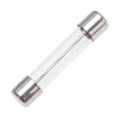
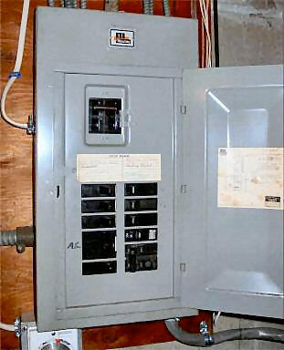
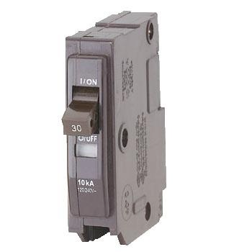
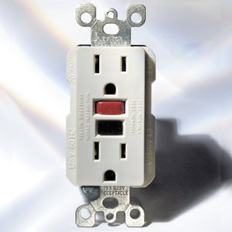
Electrical Safety
_______________
Wire in the center of the fuse melts when _____ ______ ____________ passes through it
__________ __________________
A switch opens when the ________ is too high
Ground-fault circuit interrupter (_________)
Monitors current flowing to and from an outlet or appliance
If current is _____ _______ → current is escaping and the GFCI opens the circuit to prevent serious electric shock

Slide 12
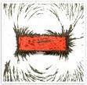
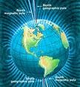
Magnetism
All magnets have _______ & _______ ______
If you break a bar magnet in half, each half will become a bar magnet with two poles
Rule for magnetic poles: like poles ________/opposites ___________
Magnetic Field = region in which magnetic forces can act
Earth has one around it (__________________); strongest at poles
Magnetic lines of force define these areas
Electrons in atoms spin, causing the magnetic field
Magnetic Force – as two magnets move farther apart, the ___________ ______ ______

Slide 13
Electromagnetism
Electricity and magnetism are inseparable
____________________: made by winding wire around an iron core
Will have N and S poles
Polarity of magnet depends on polarity of electric current
Magnetism can induce _______________
Electricity can induce _______________

Slide 14
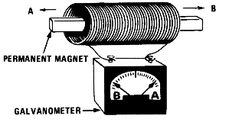
Electromagnets
Electric Wire wrapped around an iron core
These are _____________ ___________; can be turned on and off
Ex. Doorbells, telephones, electric motors
Moving a magnet inside a coil of wire will induce a voltage in the coil
The _____________ the magnet moves → the _________ the voltage

Slide 15
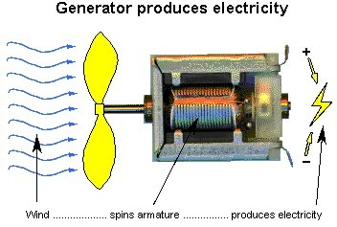
Electric Generator
Changes _____________ energy into ______________ energy
Loop of wire (conductor) spins inside a magnetic field to create electricity; known as an electromagnetic induction
Most of the power you use everyday comes from ____________________
Burning of fossil fuels creates _______ that spins a _________ which will turn the coils in a generator
In Michigan, the major source of fossil fuel is __________

