Slide 1
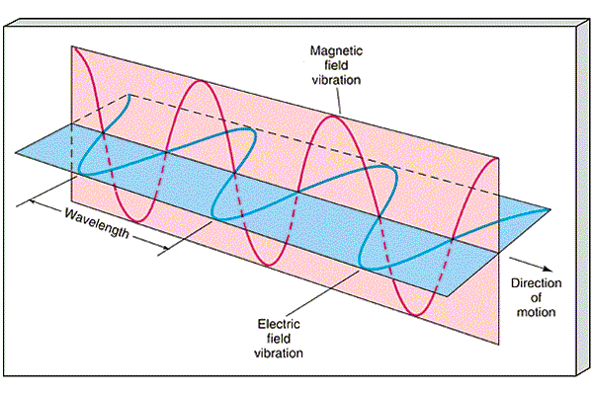
The Electromagnetic Spectrum and Light Electromagnetic Waves
Transverse waves
2 components:
_______________
_______________
_______________ to each other
Can travel through a vacuum or matter
Light does not travel in a single straight line – it travels out in all directions

Slide 2
Speed of Light (c)
Speed in a vacuum:
c = _____________ m/s
Speed = ___________ X ____________

Slide 3
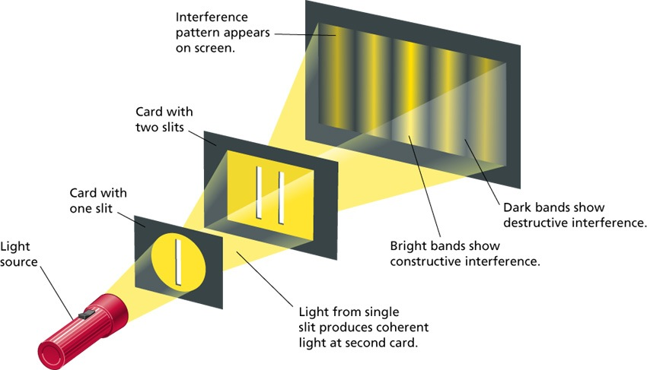
Wave or Particle???
Electromagnetic waves sometimes act like:
A ___________

Slide 4
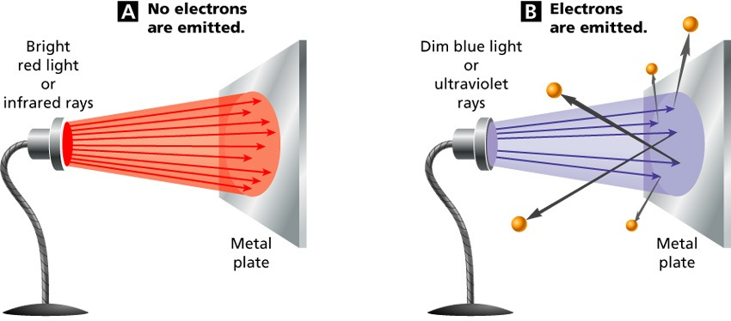
Wave or Particle???
Electromagnetic waves sometimes act like:
A _________
Made up of
_________
Packets of
electromagnetic
energy
photons travel outward in ______ ____________

Slide 5
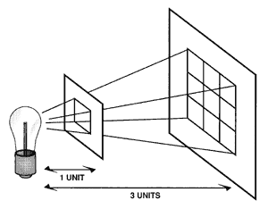
Intensity
The intensity of light ___________ as it photons travel _______ from the source

Slide 6
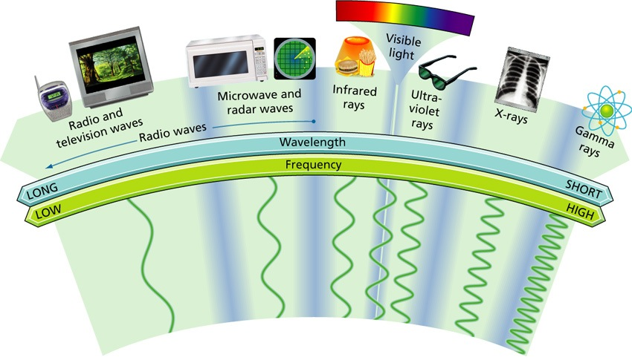
Electromagnetic Spectrum
The full range of frequencies for electromagnetic waves

Slide 7
E.S. includes:
________________
Longest wave length
Includes radio, television, microwaves, radar
Infrared rays
________________
Ultraviolet rays
________________
Gamma rays
Shortest wavelengths

Slide 8
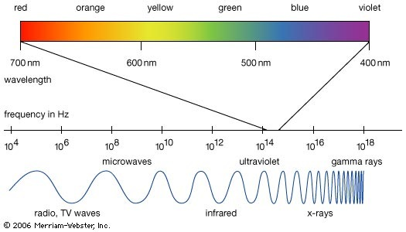

Slide 9
Light & Materials
Materials can be:
________________ – transmits light (i.e. water, clear glass)
________________ – can see through but the objects are not clear or distinct (i.e. frosted glass, milk carton)
________________ – either absorbs or reflects all light; does not allow any light to pass through (i.e. desk, wall, wood door)

Slide 10
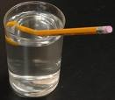
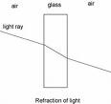
Interactions of Light
_______________
Regular reflection
Clear sharp image
Diffuse reflection
Blurred image or no image at all
_______________
Bending of light when it travels from one medium to another

Slide 11
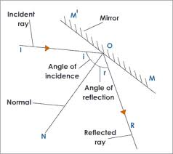
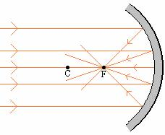
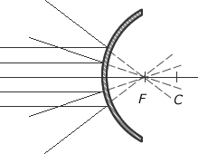
Types of Mirrors
_________________
Flat, regular reflection
_________________
Curved away from object in front of it
_________________
Curved toward the object in front of it
Notes:
Flat mirror – plane mirror
Law of Reflection – angle of incidence equals the angle of reflection
Refraction – due to a change in speed

Slide 12
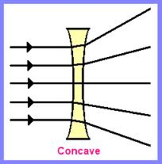
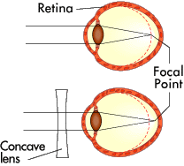
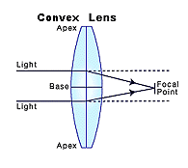
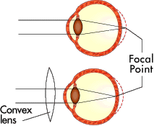
Types of Lenses
__________________
___________________ person’s eyeball is too ___________
Corrected with a concave lens
___________________
___________________ person’s eyeball is too ____________
Corrected with a convex lens

Slide 13
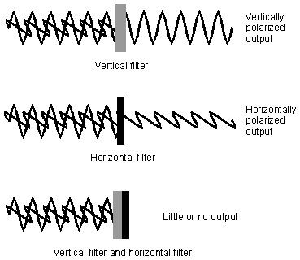
Interactions of Light
______________________
Light with waves vibrating in one direction
_______________________
Light is redirected as it passes through a medium – the reason the sky looks blue and why at sunset the sky looks red

Slide 14
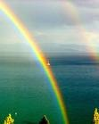
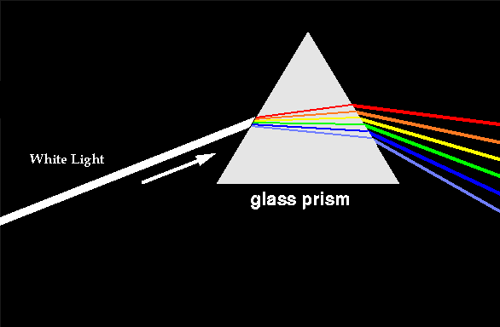
White Light
White sunlight is made up of _________ __________ of the visible spectrum – production of a rainbow
colors in sunlight undergo _____________
___________ prism experiments

