Slide 1
The Electromagnetic Spectrum and Light

Slide 2
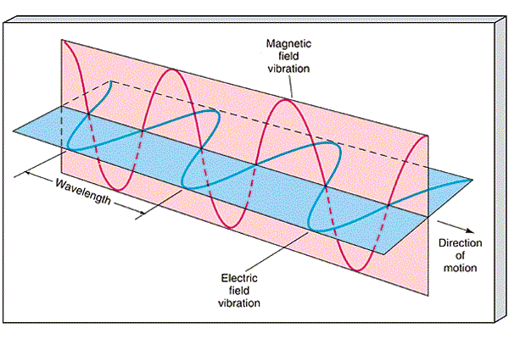
Electromagnetic Waves
Transverse waves
2 components:
Electric field
Magnetic field
Perpendicular to each other
Can travel through a vacuum or matter
Light does not travel in a single straight line – it travels out in all directions

Slide 3
Speed of Light (c)
Speed in a vacuum:
c = 3.00 X 10⁸ m/s
Speed = wavelength X frequency
Notes:
Speed of light refers to all waves of the electromagentic spectrum

Slide 4
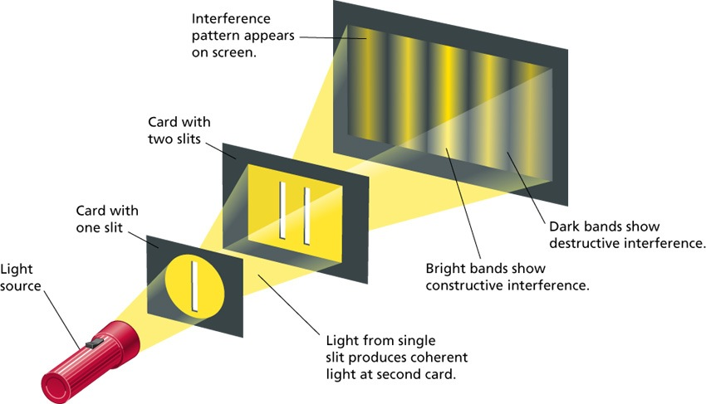
Wave or Particle???
Electromagnetic waves sometimes act like:
A wave

Slide 5
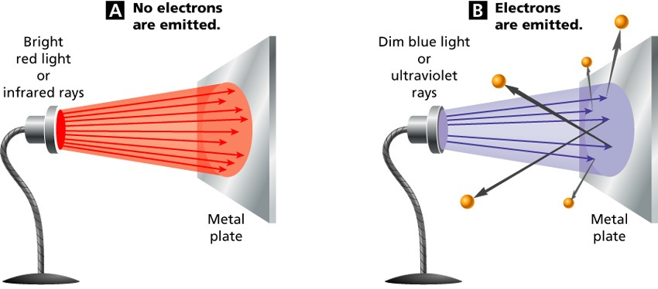
Wave or Particle???
Electromagnetic waves sometimes act like:
A particle
Made up of
photons
Packets of
electromagnetic
energy
photons travel outward in all directions
Notes:
Photon travel in all directions

Slide 6
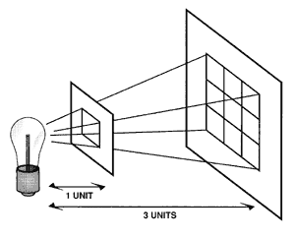
Intensity
The intensity of light decreases as its photons travel farther from the source

Slide 7
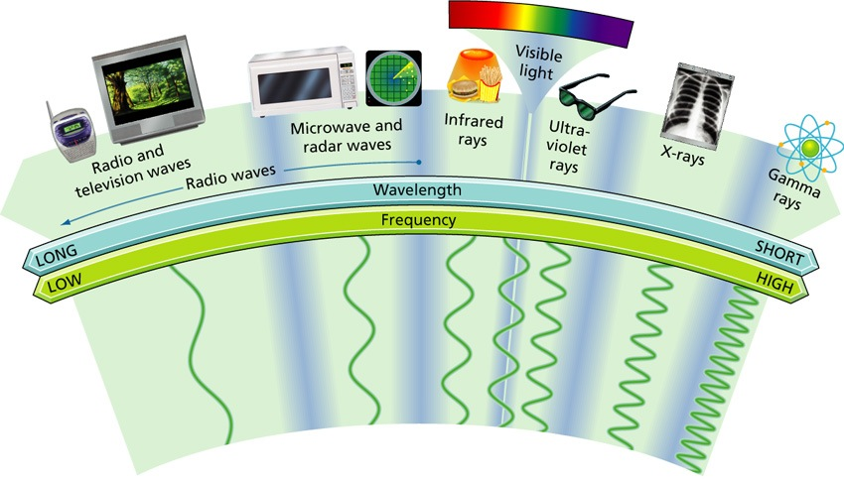
Electromagnetic Spectrum
The full range of frequencies for electromagnetic waves

Slide 8
E.S. includes:
Radio waves
Longest wave length
Includes radio, television, microwaves (cell phones), radar
Infrared rays
Visible light
Ultraviolet rays
X-rays
Gamma rays
Shortest wavelengths
Notes:
Microwaves – carry cell phone signals

Slide 9
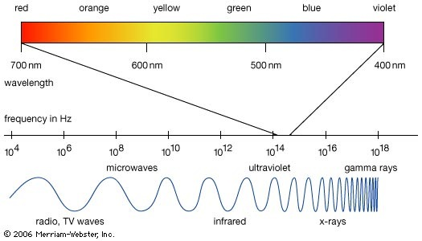

Slide 10
Light & Materials
Materials can be:
Transparent – transmits light (i.e. water, clear glass)
Translucent – can see through but the objects are not clear or distinct (i.e. frosted glass, milk carton)
Opaque – either absorbs or reflects all light; does not allow any light to pass through (i.e. desk, wall, wood door)

Slide 11
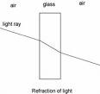
Interactions of Light
Reflection
Regular reflection
Clear sharp image
Diffuse reflection
Blurred image or no image at all
Refraction
Bending of light when it travels from one medium to another
Notes:
Flat mirror – plane mirror
Law of Reflection – angle of incidence equals the angle of reflection
Refraction – due to a change in speed

Slide 12
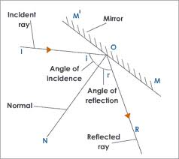
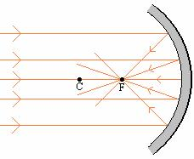
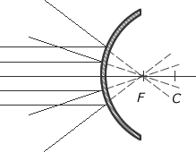
Types of Mirrors
Plane
Flat, regular reflection
Concave
Curved away from object in front of it
Convex
Curved toward the object in front of it
Notes:
Flat mirror – plane mirror
Law of Reflection – angle of incidence equals the angle of reflection
Refraction – due to a change in speed

Slide 13
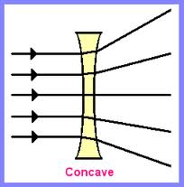
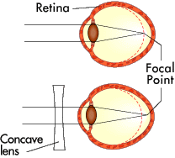
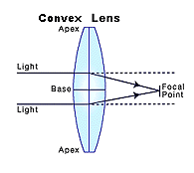
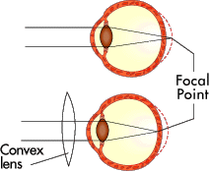
Types of Lenses
Concave
Nearsighted person’s eyeball is too long
Corrected with a concave lens
Convex
Farsighted person’s eyeball is too short
Corrected with a convex lens

Slide 14
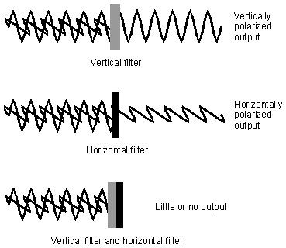
Interactions of Light
Polarization
Light with waves vibrating in one direction
Scattering
Light is redirected as it passes through a medium – the reason the sky looks blue and why at sunset the sky looks red
Notes:
Polarized sunglasses work by blocking light waves that vibrate in one plane.

Slide 15
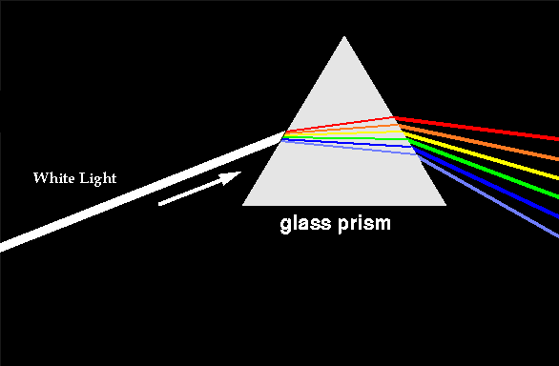
White Light
White sunlight is made up of all the colors of the visible spectrum – production of a rainbow
colors in sunlight undergo dispersion
Newton’s prism experiments
Notes:
Newton’s prism experiment
When droplets of water in the atmosphere act like prisms,, the colors in the sunlight undergo dispersion
Sunsets appear reddish because the light from the sun is scattered. Small particles scatter short wavelengths more; therefore scattering blue light more than red.

