Slide 1
II. Evidence for Evolution:

Slide 2
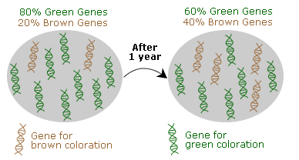
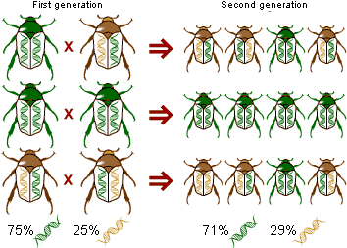
Types of Evolution
______________________:
1. evolution on the__________________.
2. generation to generation change in
____________________________.

Slide 3
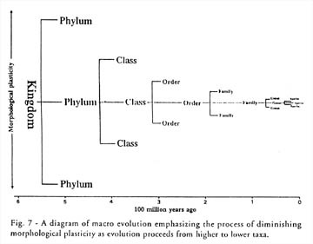
B. _______________
More ____________ biological changes
Evidence found in _________________
Includes:
____________________________________
_______________ of species
Evolution of major______________________________

Slide 4
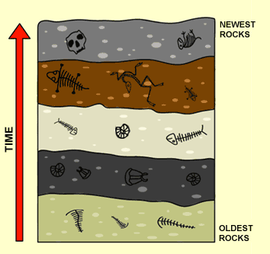
_______________________:
Left the _____________________
Preserved remains or markings left by __________
Provide evidence of Earth’s _______________
Can link past & present

Slide 5
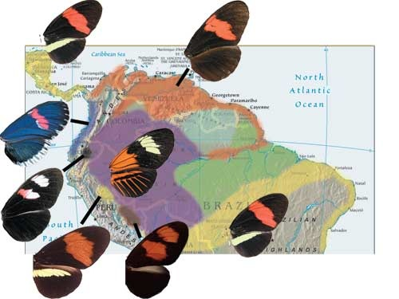
_________________________________
_______________________ between organisms in different parts of the world
Serves as clue as to how species ___________
Organisms are more similar to nearby populations with different environments than populations that live far away with similar environments
http://www.tolweb.org/tree/ToLimages/melp_map.jpg
Notes:
Darwin noted that blind cave-dwelling animals are more like the animals living near the cave – despite the great difference in cave and surface environments – than they are to animals living in distant caves, even though there is great similarity in the caves’ environments.

Slide 6
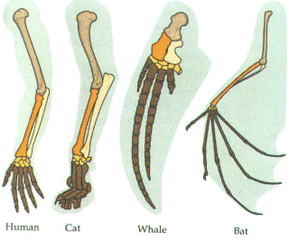
__________________________
1. ________________________: structures that are embryologically _________, but have ___________________
ex: forelimbs of mammals
consist of same skeletal
parts but function differ
http://taggart.glg.msu.edu/isb200/HOMOL.GIF

Slide 7
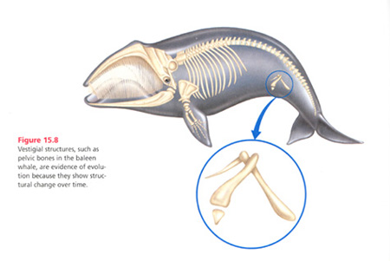
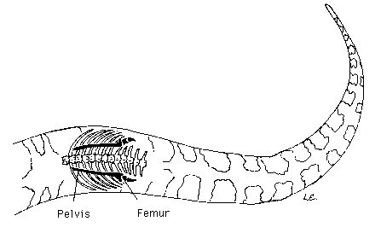
____________________:
a. Features that apparently serve ___________________
b. are allegedly holdovers from an evolutionary past
ex: pelvic bone of whales
Python Pelvis & Leg
http://www.answersingenesis.org/assets/images/articles/ee/v2/whale-vestigial-structure.jpg

Slide 8
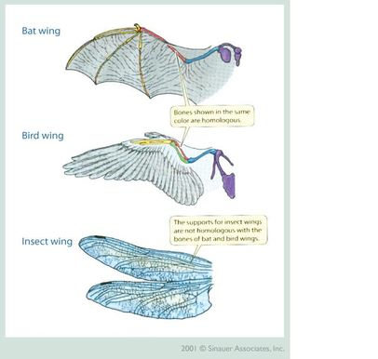
3. _____________________ – have ______________ but __________________
NOT evidence for evolution (Convergent evolution)
Ex: Bird wing and
Butterfly wing

Slide 9
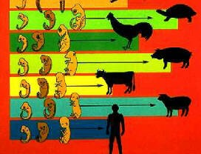
____________________________________
1. embryos of some organisms have ____________________________
* Indicates common ancestor
http://images.google.com/images?um=1&hl=en&safe=vss&q=embryological+development

Slide 10
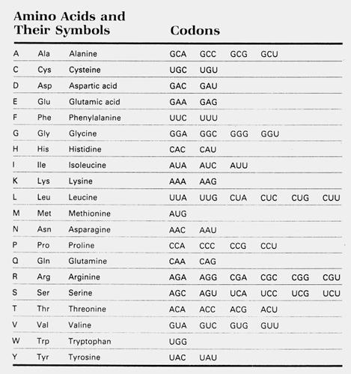
____________________
_________________________________
____________ the differences → less likely shared ancestor
http://www.mdibl.org/~dtowle/mbw/1.%20%20Primer%20Design_files/image006.jpg

Slide 11
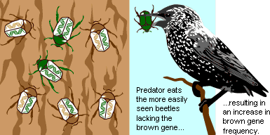
F. How does evolution occur?
__________________________
___________________ - a change in the gene pool of a population due to ________

Slide 12
Populations that are NOT evolving
Hardy-Weinberg _______________
Population that ___________undergo change in gene pool
Are not ________________
Frequency of gene pool is ___________
Rarely occurs for long period of time in nature
Provides “no change” baseline for comparison

