Slide 1
Homeostasis

Slide 2
Homeostasis:
A. Maintenance of a stable internal environment
B. Stimulus → response
C. Physical & chemical parameters that an
organism must keep for proper functioning of:
1. cells
2. tissues
3. organs
4. organ systems

Slide 3
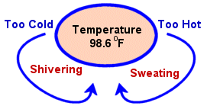
D. Examples
1. Body Temp: shivering and sweat
2. Enzymes function best at certain
temps and pH
3. Proper water levels
http://images.google.com/imgres?imgurl=http://www.geo.arizona.edu/Antevs/nats104/giardia.gif&imgrefurl=http://www.geo.arizona.edu/Antevs/nats104/00lect08.html&h=365&w=627&sz=205&hl=en&start=11&tbnid=xcT8i2Z4pxH5JM:&tbnh=79&tbnw=136&prev=/images%3Fq%3Dsingle%2Bcell%2Borganisms%2B%26gbv%3D2%26hl%3Den%26sa%3DG

Slide 4
http://images.google.com/images?hl=en&q=homeostasis&gbv=2
http://images.google.com/images?hl=en&q=homeostasis&gbv=2

Slide 5
E. More Examples:
1. Concentration of O₂ and CO₂
2. pH of internal environment
3. Conc. of nutrients and waste prdts.
4. Conc. of salt and other electrolytes
5. Volume and pressure of extra-cellular fluid

Slide 6
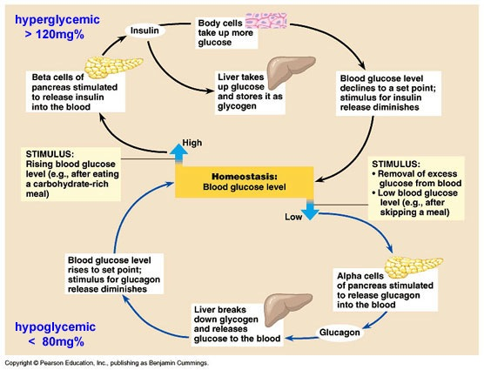
http://fig.cox.miami.edu/~cmallery/150/physiol/c45x10glu-homeostasis.jpg

Slide 7
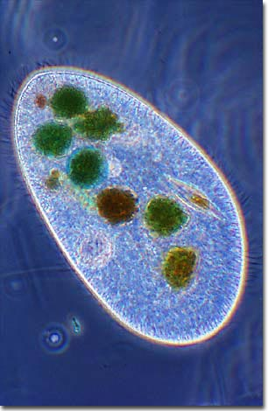
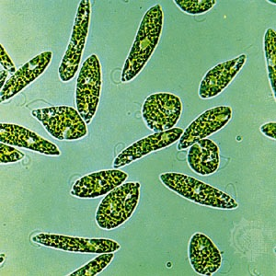
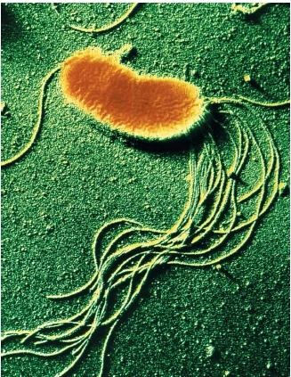
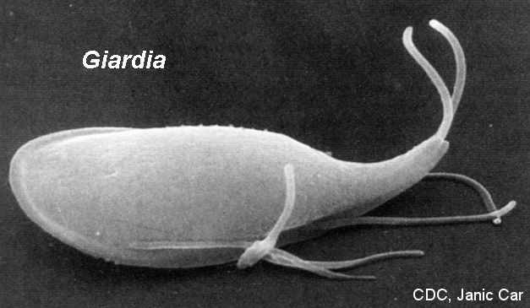
Single Cell Organisms
Surrounded by external environment
Cell membrane moves mat’ls in and out
Ex: dump wastes
http://images.google.com/images?gbv=2&hl=en&q=single+cell+organisms+&btnG=Search+Images

Slide 8
Multicellular Organisms
A. Organs & systems regulate
B. Controlled mainly by:
1. Nervous System
a. For rapid responses
b. Avoid hot stove
2. Endocrine System (chemical)
a. Longer-term responses
b. Maintain calcium levels

Slide 9
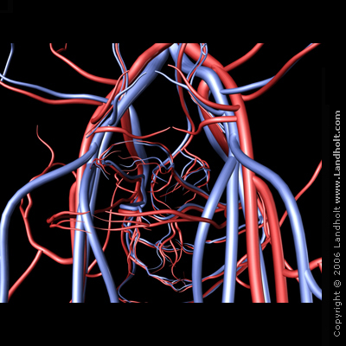
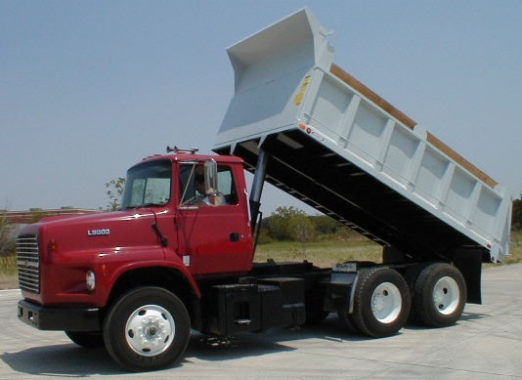
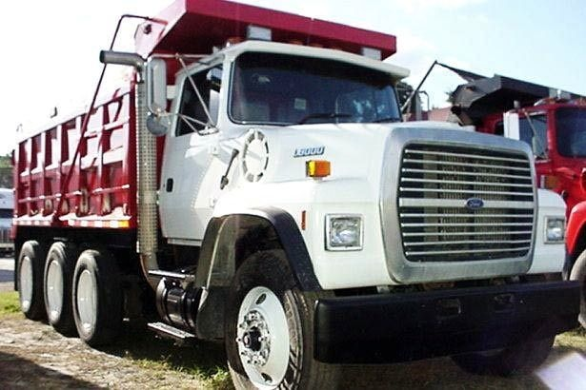
C. Cells can dump wastes → moved by
circulatory system
http://
images.google.com/images?gbv=2&hl=en&q=blood+vessel+diagram&btnG=Search+Images
http://images.google.com/images?gbv=2&hl=en&q=dump+truck+ford

Slide 10
D. Types of Biological Feedback
1. Negative feedback
a. Turns off the stimulus (reverse)
b. Stop production of chemical
c. Used by most body systems
2. Positive Feedback
a. Input increases or accelerates the response
b. Oxytocin causes increase in frequency/strength of contractions
c. Increases production of oxytocin

Slide 11
http://trc.ucdavis.edu/biosci10v/bis10v/week10/homeostasis.gif

Slide 12
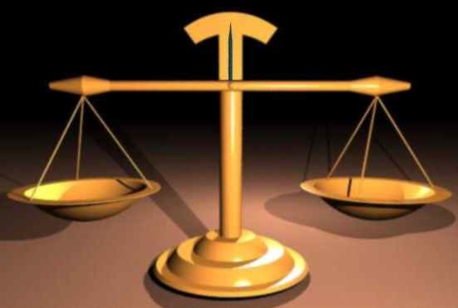
IV. Homeostasis depends on:
the action and interaction of many body systems
B. maintain conditions in which the body can best operate

