Slide 1
V. How Does Evolution Work?

Slide 2
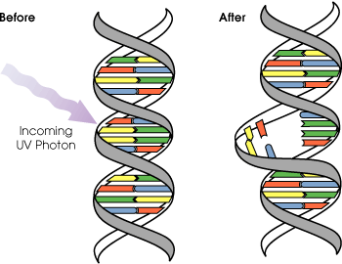
Mutations:
1. changes in the DNA or Chromosomes

Slide 3
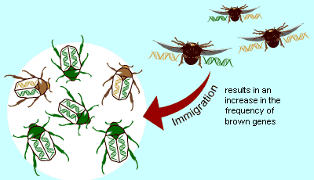
Migration (Gene Flow)
When organisms leave an area & go to another
They take their genes
http://images.google.com/images?um=1&hl=en&q=migration+and+evolution

Slide 4
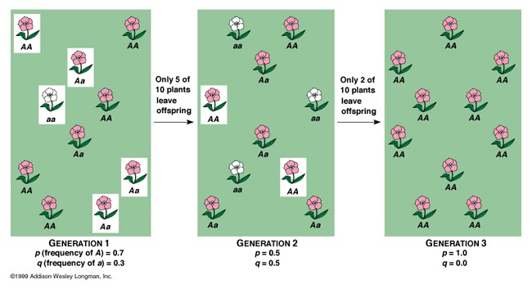
C. Genetic Drift
1. In smaller populations, there may be large changes in gene pool due to chance
2. Natural disaster, random
http://fig.cox.miami.edu/~cmallery/150/evol/23x4.jpg

Slide 5
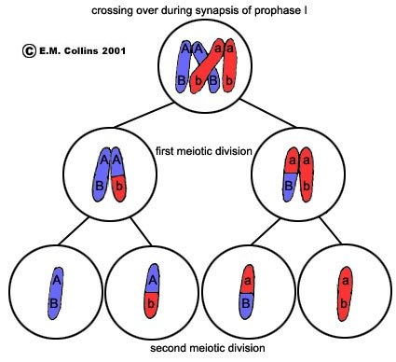
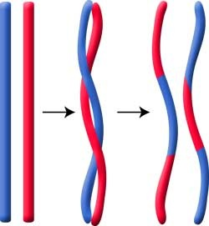
Non-random Mating and Genetic Recombination
1. every sperm & egg different
2. provides different combinations of genes
3. crossing over in Prophase I
http://waynesword.palomar.edu/images/cross3.jpg

Slide 6
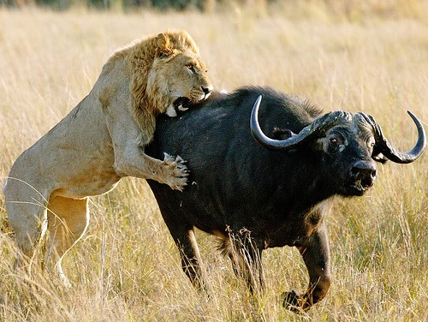
Natural Selection
Organism with most fit genes live and reproduce
Not better organisms – best adapted to specific changes in environment
Survival of the Fittest
http://farm1.static.flickr.com/49/125046333_7123c38e73.jpg

Slide 7
VINT
V = Variation
I = Inheritance
N = Natural Selection
T = TIME
-can happen in a few generation
-major change (speciation) long periods of time

