Slide 1
Immune System
Lines of Defense

Slide 2
First Line of Defense:
Physical Barriers
(Nonspecific)

Slide 3
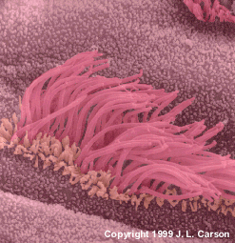
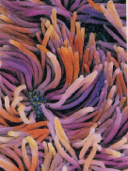
Physical Barriers:
Skin
Body Secretions -mucous membrane -sweat
-tears -saliva
Cilia on cells which secrete mucous in the respiratory tract (Modern Bio. 956)

Slide 4
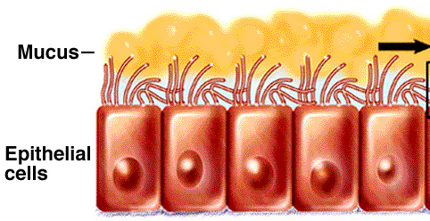

Slide 5
Second Line of Defense:
Inflammatory Response
(Nonspecific)

Slide 6
Inflammatory Response:
Body’s initial local healing reaction to an injury
Phagocytes: white blood cells that surround, engulf, and consume foreign particles
Macrophage: largest phagocytes that consume large numbers of invading pathogens

Slide 7
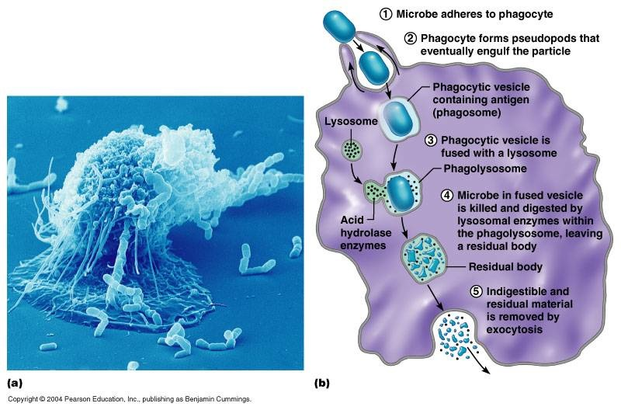

Slide 8
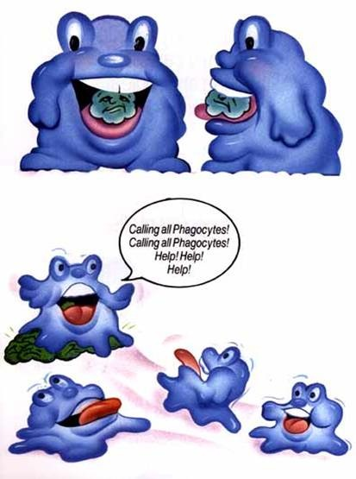
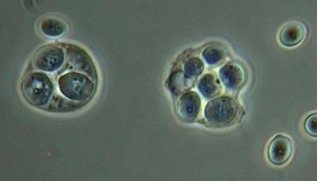
Macrophage engulfing yeast cells

Slide 9
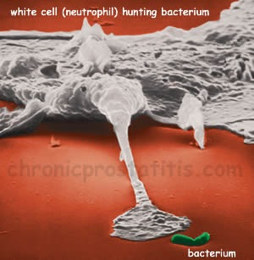
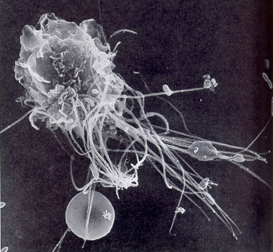
Macrophage attacking e-coli

Slide 10
Inflammatory Response
1. Small cut triggers
2. Injured cells release a chemical alarm
3. Capillaries swell
4. Phagocytes released
5. Phagocytes destroy pathogens

Slide 11
Inflamatory Response

Slide 12
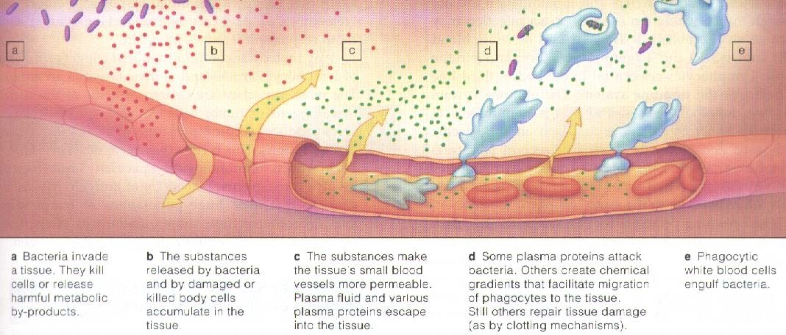

Slide 13
Third Line of Defense:
The Immune System
(Specific)

Slide 14
The Immune System
1.
Immunity: the body’s ability to recognize and resist infection by specific pathogens/toxins

Slide 15
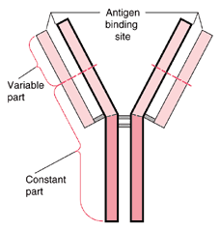
2.
Active immunity: your body produces its’ own substances (antibodies) to fight pathogens
http://www.merck.com/media/mmhe2/figures/fg183_3.gif

Slide 16
Antibodies vs. Antbiotics
Antibodies – made by your body, can work on MOST pathogens (including viruses)
Antibiotics - Prevent bacterial cell wall from forming, NOT made by your body
Symptoms of illness are produced when pathogen releases toxins

Slide 17
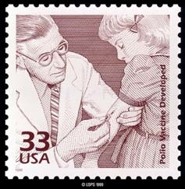
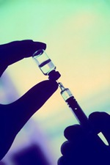
3.
Passive immunity: antibodies are produced by another source
Vaccine: formed from weakened, dead, or parts of pathogens to develop immunity
http://www.vpul.upenn.edu/ohe/library/cold/vaccine.jpg

Slide 18
