Slide 1
Infectious Diseases
images.google.com/imgres?imgurl=http://
http://images.google.com/images?q=virus&hl=en

Slide 2
Disease: change in the ability of the body’s cells, tissue, or organs to function properly, disturbing homeostasis
Homeostasis: maintenance of an organisms’ stable internal environment by the healthy functioning of systems in spite of changes in the surrounding

Slide 3
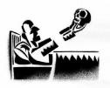
Failure of homeostasis leads to illness!

Slide 4
Communicable Disease:
a. a disease that can be passed from one host to another b. is caused by a pathogen
c. Ex: syphilis, influenza, AIDS

Slide 5
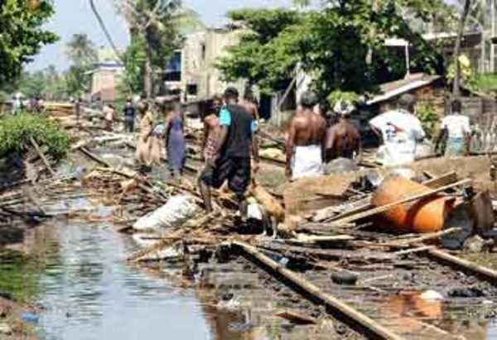
Pathogen:
a. virus or living organism that causes disease
b. Can spread from one host to another by: -direct contact
-contaminated inanimate object
- water
- air
- vector

Slide 6
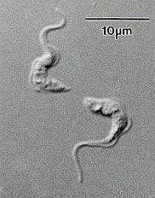
c. Types of pathogens
1. bacteria
2. virus
3. fungi
4. protozoan
(Anthrax)
(West Nile)
(Athletes Foot)
(African Sleeping Sickness)

Slide 7
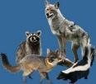
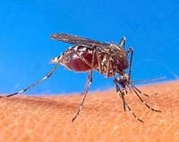
Vector: an organism that carries a disease from one host to another
a) animals → rabies
b) mosquito → West Nile Virus
c) tick → Lyme Disease
→
→
→

Slide 8
Noncommunicable Diseases
Disease not passed from host to host
Lifestyle Disease: heart disease, cancer
Inherited Disease: hemophilia, cancer
Environment Disease: allergies, asthma, skin care

