Slide 1
III. Darwin’s Theory of Natural Selection
http://images.google.com/images?hl=en&q=natural+selection&gbv=2

Slide 2
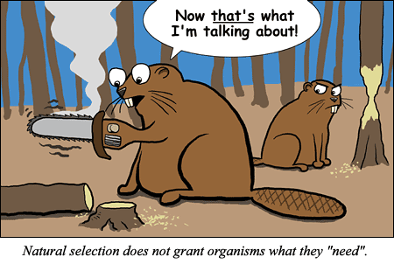
A. Natural Selection:
1. The process by which individuals w/ inherited characteristics that are well-suited to the environment leave more offspring on average than other individuals.
http://evolution.berkeley.edu/evosite/misconceps/images/misconceptions_beavers.gif

Slide 3
Natural Selection favors traits that benefit the organisms in a particular environment (NOT RANDOM).
These individuals are more likely to survive.
Live longer = Reproduce more.
Some alleles become more common and the allele frequency changes.

Slide 4
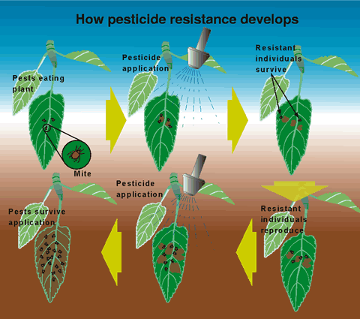
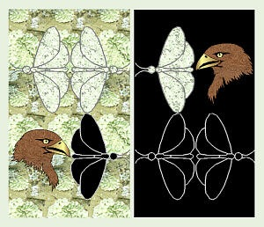

Slide 5
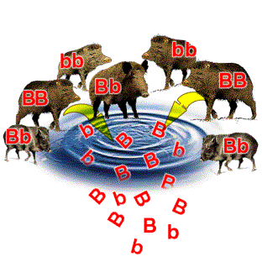
3. In order for Natural Selection to occur, there must be Genetic Variation.
a. The difference among members of the same species.
b. Causes are mutations and sexual recombination (crossing over).
http://www.detectingdesign.com/images/NaturalSelection/natura3.gif

Slide 6
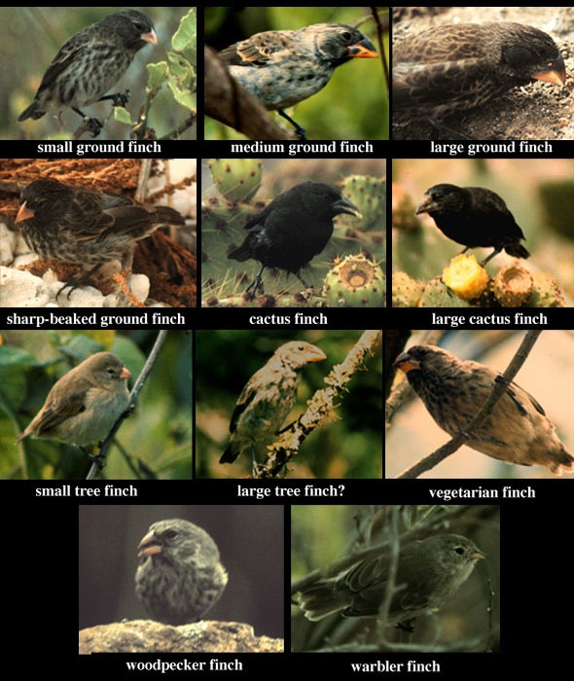
4. Could lead two isolated
populations of same
species to become
separate as adapt
to different
environments
(Speciation).
Example:
Darwin’s Finches.
http://biology.unm.edu/ccouncil/Biology_112/Images/FinchTypes.jpg

Slide 7
B. Four Principles of Natural Selection
1. Variation: __________________________ ____________________________________
2. Heritability: ________________________ ____________________________________
3. Overproduction: ____________________ ____________________________________
4. Reproductive Advantage: _____________ ____________________________________

Slide 8
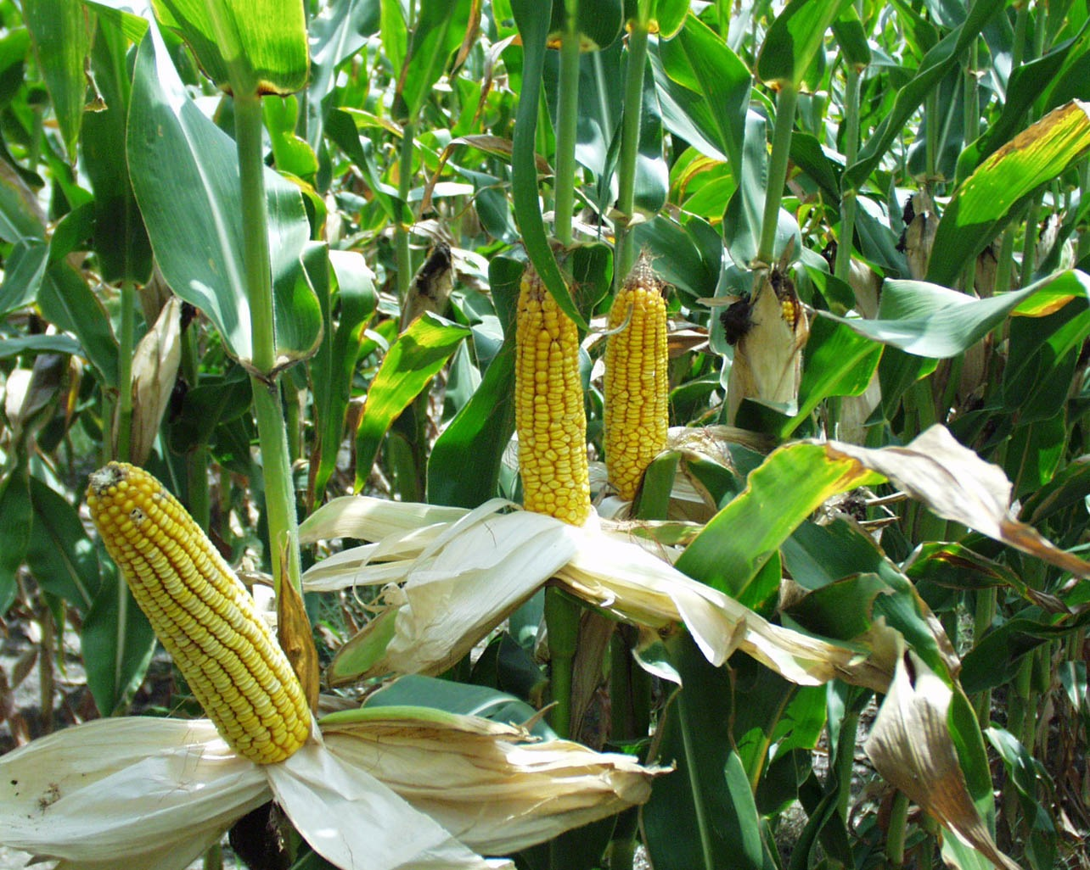
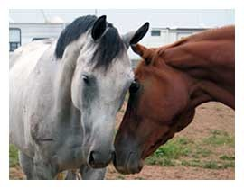
C. Artificial Selection:
Selective breeding of domesticated plants/animals to produce offspring with desired genetic traits.
Great deal of changes in relatively short period of time.
Favors traits that humans choose.

Slide 9
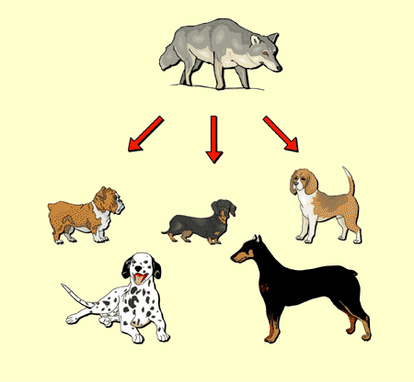
http://www.world-agriculture.com/images/water_buffalo.jpg

Slide 10
D. Clearing up Misconceptions about Natural Selection
Natural Selection does not produce adaptations.
NS can only act on the genes that are present.
NS does not produce perfect organisms.
Constantly evolving to changing environment.
Trade-offs.
NS doesn’t give organisms what they “need”.
NS is NOT RANDOM.
Favors certain genes (doesn’t “choose” them)

Slide 11
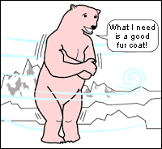
Evolution doesn’t work this way

