Slide 1
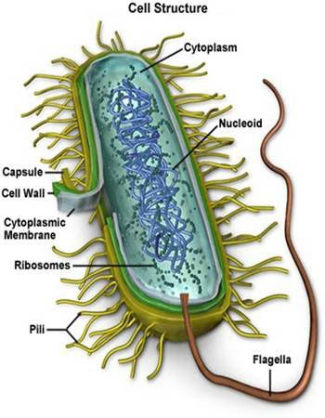
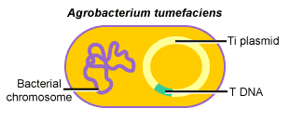
I. Prokaryotes
Cells w/o a membrane bound nucleus
Genetic material – one DNA loop
Plasmid- additional circular DNA (genetic engineering)
Cell wall
Mostly single cell
http://www.ict-science-to-society.org/Pathogenomics/images/bacteria_cell.jpg

Slide 2
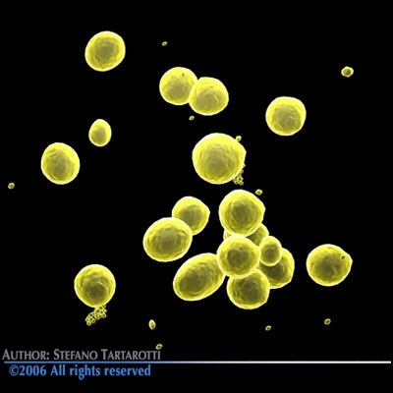
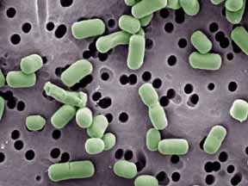
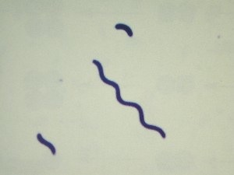
II. Bacteria
Three Common Shapes
Cocci (coccus): Spherical
Bacilli (bacillus): Rod Shaped
Spirilla (spirillum): Corkscrew
http://images.google.com/images?um=1&hl=en&sa=X&oi=spell&resnum=0&ct=result&cd=1&q=spirillum&spell=1

Slide 3
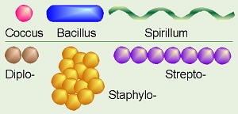
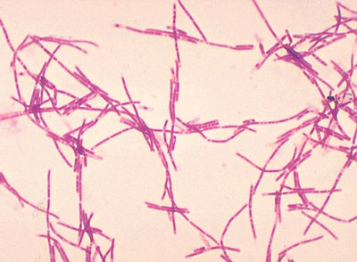
B. Colony Types (groupings)
1. diplo: two
a. diplococcus
2. staphylo: groups/masses
b. Staphylococcus
3. strepto: linear
c. streptobacillus
http://images.google.com/images?um=1&hl=en&q=diplo+coccus

Slide 4
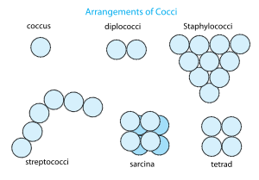
http://images.google.com/images?um=1&hl=en&q=diplo+coccus

Slide 5
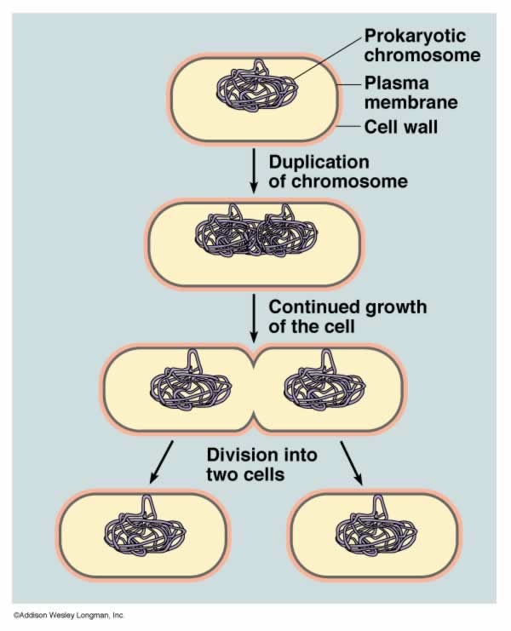
C. Reproduction
1. Binary Fission – divides into two
http://www.uic.edu/classes/bios/bios100/lecturesf04am/binfission.jpg

Slide 6
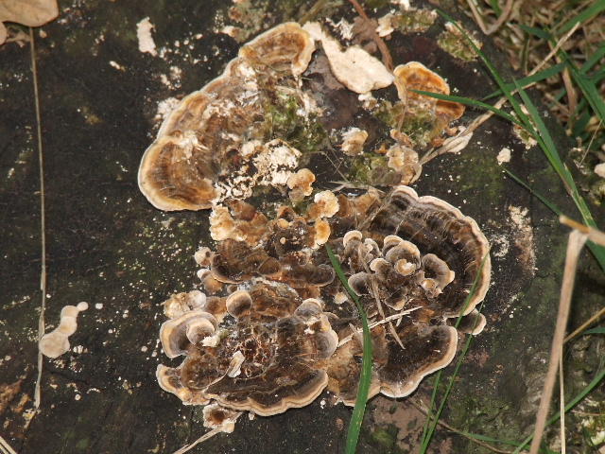
D. Nutrition
1. Most heterotrophs – depend on other organisms for food
2. saprophytes: decomposers (feed on dead organic mat’l)
3. parasites: disease causing
http://www.wellhall.org.uk/resources/183/571/63/saprophyte.JPG

Slide 7
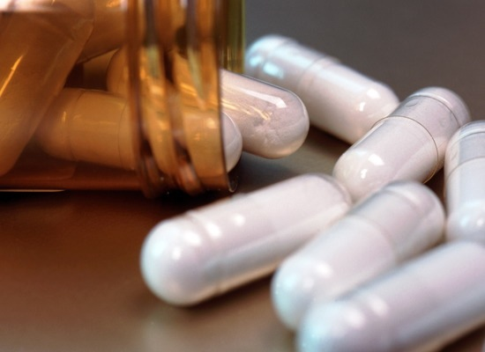
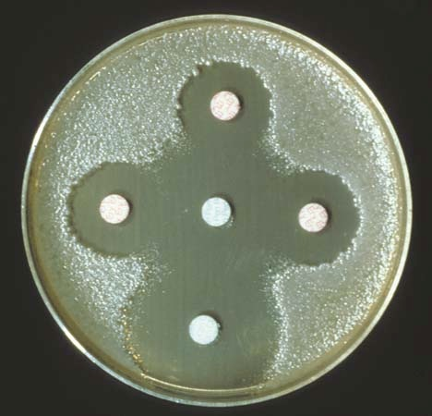
E. Antibiotics: chemical capable of inhibiting the growth of some bacteria
1. Penicillin, tetracycline, streptomycin
http://images.google.com/images?gbv=2&hl=en&q=antibiotic&start=18&sa=N&ndsp=18

Slide 8
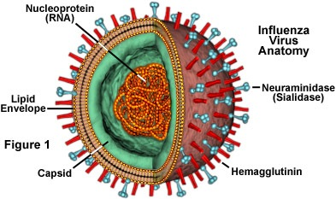
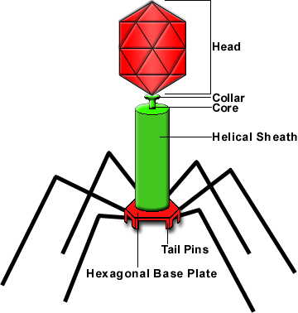
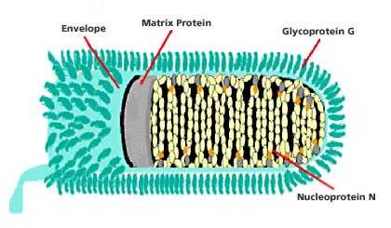
III. Virus
Non-living particle (no respiration, growth, etc)
Reproduce only in a host cell
Structure:
Inner core of nucleic acid
Protein coat (many different shapes)

Slide 9
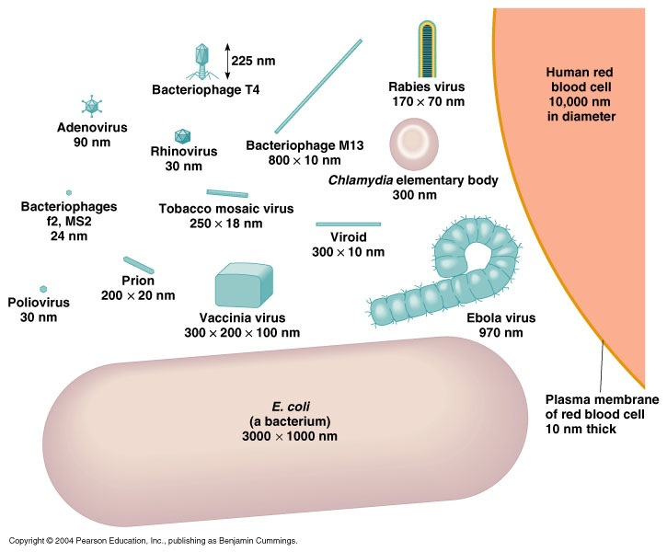
http://images.google.com/images?hl=en&q=virus%20sizes&um=1&ie=UTF-8&sa=N&tab=wi

Slide 10
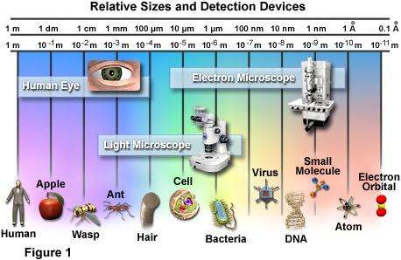
http://micro.magnet.fsu.edu/cells/images/cellsfigure1.jpg

Slide 11
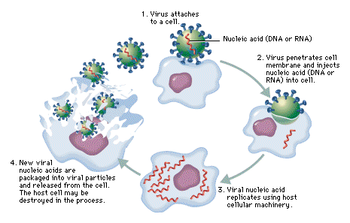
Attachment
Entry
Release/Lysis
Replication/Assembly

