Slide 1
Types of Natural Selection/Coevolution

Slide 2
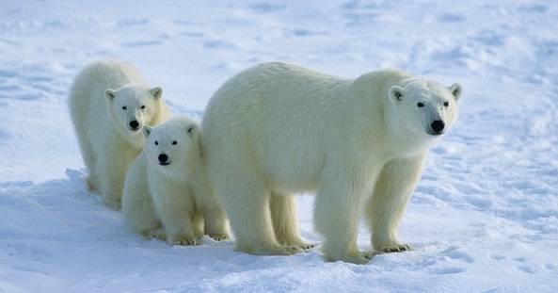
Normal Distribution of a Population
Polar Bear Coats

Slide 3
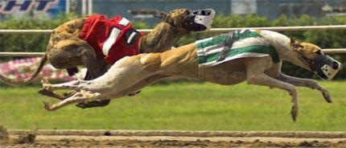
1. Directional Selection
One extreme phenotype is favored over the “normal” phenotype in a population.
Causes a shift of the alleles in one direction.
Example: Greyhound breeding
Select those who are fastest

Slide 4
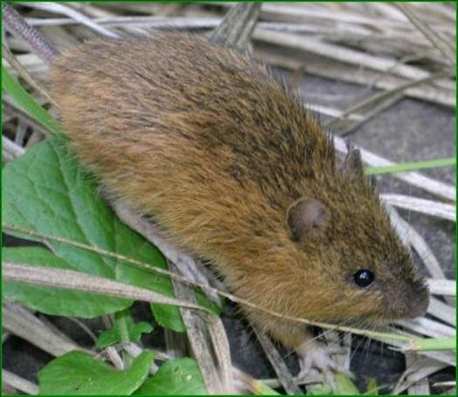
2. Stabilizing Selection
The normal/average phenotype is favored in a population.
Causes a shift of the alleles inward.
Example: Mice survival in the wilderness
Small enough to hide from predators
Large enough to compete with rats for food
Medium size is ideal

Slide 5
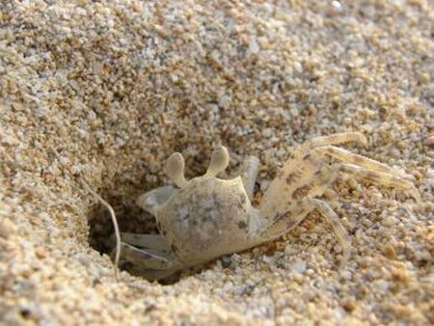
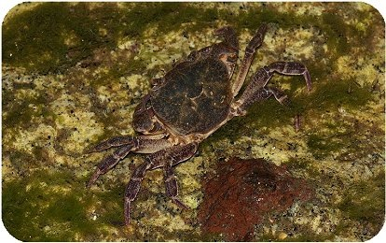
3. Directional Selection
Both extremes of the phenotypes are favored over the “normal” phenotype in a population.
Causes a shift of the alleles in both directions.
Example: Crab color
Darker crabs blend in well in the water
Lighter crab blend in well on land
Medium colored crabs don’t blend in well on land or in the water.

Slide 6
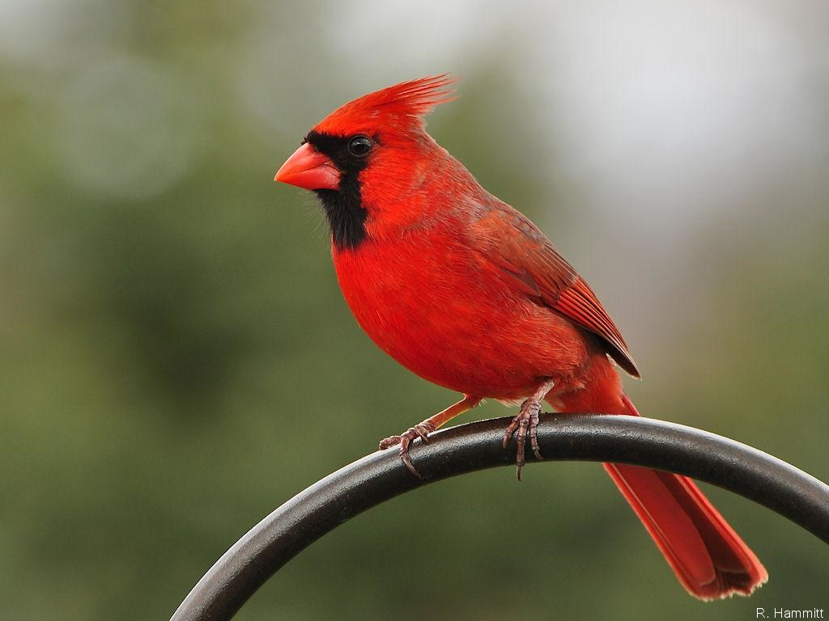
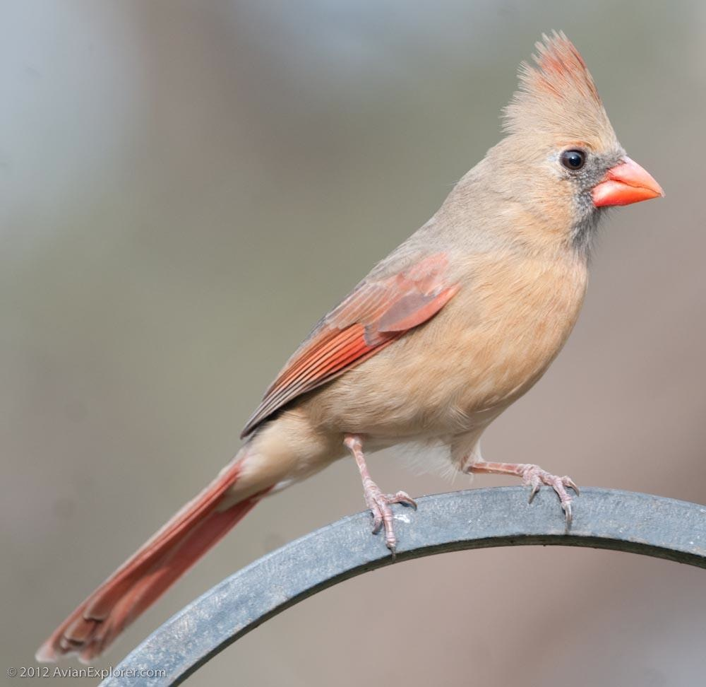
4. Sexual Selection
Selection driven by competition for mates.
Females of the species favor/pick the males that they are more attracted to.
Explains why…
Male cardinals are bright red
Female cardinals are brown

Slide 7
5. Coevolution
Organisms evolve in response to another organism.

