Slide 1
Variations of Inheritance Patterns
Notes:
Ch. 11.2

Slide 2
I. Incomplete Dominance (Intermediate Inheritance )
Neither allele is dominant
Heterozygous traits are a combination of two alleles
Appearance of a 3rd phenotype

Slide 3
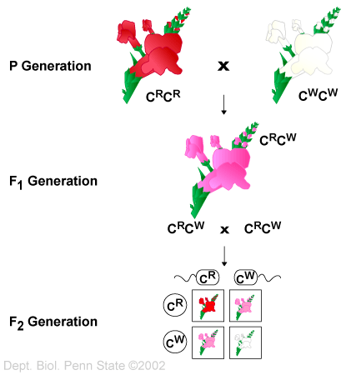
Notes:
Red is incompletely dominant to white so when both alleles are present, the appearance is a combination of the traits (pink)

Slide 4
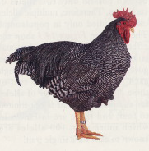
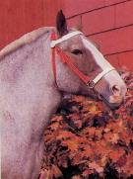
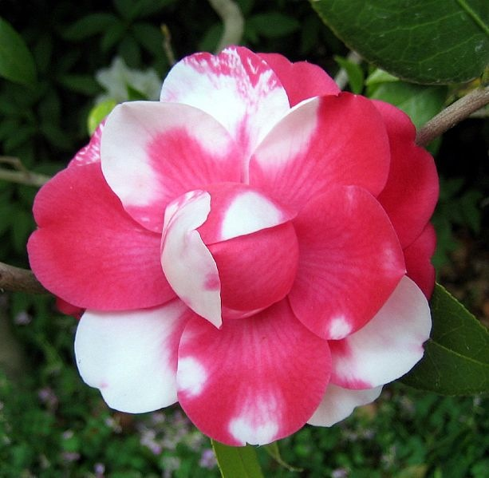
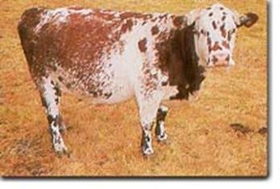
II. Codominance
A. Heterozygous expresses both traits
B. Examples: Spotted Animals
Notes:
In codominance, when two different genes are present, they are both expressed (AB blood type, brown and white cow, black and white chicken, pink and white flower)

Slide 5
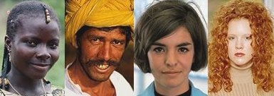
III. Polygenic Inheritance:
A. Two or more genes affect a single character
B. Height, skin color, eye color, finger pattern.
C. AaBbCc
Notes:
These are not contrasting traits like Mendel studied, instead these traits can produce a range of phenotypes

Slide 6
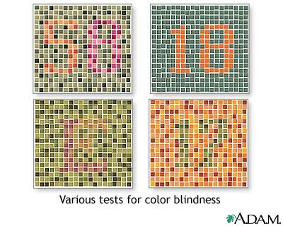
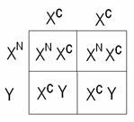
IV. Sex-Linked Traits
Gene carried on sex-chromosome
Red-Green Color Blindness/Hemophilia
Notes:
Both Red-Green Color blindness and hemophilia are carried on the X chromosome.

Slide 7
Red-Green Color Blindness
Recessive X-Linked disorder
X^{N} shows the normal trait on the X chromosome
X^{C} shows the trait for color blindness on the X chromosome
Y chromosome is normal
Notes:
Can do punnett square for colorblindness
Hemophilia is also X-linked recessive

Slide 8
Red-Green Color Blindness
Males receive a Y chromosome from their father and an X chromosome from their mother
Males receiving X^{C} from their mother will be color blind (more common)
Females must receive X^{C} from
mom AND dad to be colorblind
(Rare)
Notes:
Since males only have 1 X chromosome, if they receive the gene for colorblindness from their mom they will be color blind. Colorblindness is recessive but they don’t have another X chromosome.
X-linked recessive disorders are more commonly expressed in males
Could also do Punnett square for normal mother and colorblind father (0% of sons would be colorblind and 50% of daughters would be carriers

