Slide 1
Waves
Physics of Waves

Slide 2
The Basics of Waves
Involves kinetic energy(energy in motion)
A wave is a disturbance that transfers energy through matter or space
The energy is transferred through a medium(liquid, solid, or gas)
The medium has no overall movement itself(simply transfers the energy)

Slide 3
Waves Traveling Through a Medium
Molecules of medium vibrate
Waves move forward, but medium stays put(ex. buoy in water)
Density: as density of medium increases, the speed of wave decreases
Elasticity: waves travel faster through mediums who can return to original shape more quickly(ex. steel vs. air)

Slide 4
Transverse Waves
Motion of medium is at right angles to the direction in which wave travels(ex. ocean wave, string)
Two primary parts:
crest- high point of wave(maximum upward displacement of medium particle)
trough- low point of wave(maximum downward displace of medium particle)

Slide 5
Longitudinal Wave
Compressions- crowding of molecules in medium
Rarefactions- fewer molecules in medium after compression
Wave moves when one layer of molecules pushes against another layer
Motion is parallel to direction of wave
^{ex.} clapping hands(feel the air)
^{ex.} sound waves(are all longitudinal)

Slide 6
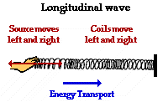
Longitudinal Waves
Compressions: Areas where molecules pinch together
Rarefactions: Area where molecules are spread apart
Wavelength: Distance between 2 compressions or rarefactions
Frequency: # of compressions passing a certain point each second

Slide 7
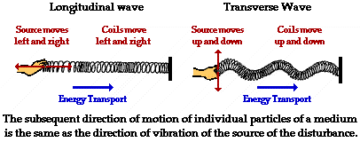

Slide 8
Characteristics of a Wave
Amplitude- total distance molecules are displaced(indicates energy of wave)
Wavelength(λ )- distance between 2 consecutive crests or troughs(cm or m)
Period – The time required to complete one full wave cycle
Frequency(Hz)- number of waves per unit time…………. 1Hz = 1 wave/second
Speed- is constant in a given medium speed= frequency x wavelength

Slide 9
Anatomy of a Wave
amplitude
crest
crest
wavelength
amplitude
wavelength
trough

Slide 10
Speed of Waves
** speed = frequency x wavelength **
Ex. Freq= 4 Hz
λ = 2m
speed=(4Hz)(2m)= 8m/sec
Since speed is constant in a medium:
1. When frequency ↑, wavelength ↓
2. When frequency ↓, wavelength ↑

Slide 11
Sample Problems
A wave has a frequency of 10 Hz and a wavelength of 30m. Calculate its speed.
If the frequency of a wave in question 1 were 20 Hz, what would be its wavelength?

Slide 12
Problem Solutions
10 (X) 30 = 300m/s
300/20 =15 m

Slide 13
Wave Interactions
Press any key to continue

Slide 14
Reflections
When a wave strikes a barrier and bounces back(^{ex.} water wave hitting breakwall)
incident wave: incoming wave
reflected wave: bounced-back wave
normal
incident wave
reflected wave
i
r

Slide 15
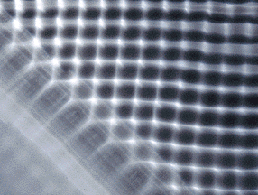
The reflection of waves in a ripple pool

Slide 16
Refraction
Bending of waves due to change in medium
Waves bend because the speed of a wave changes from one medium to another
^{Ex.} Light slows down when going from water to air

Slide 17
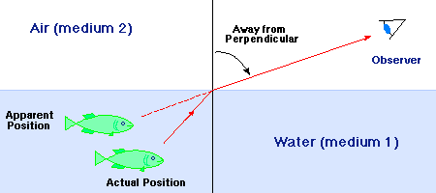
Refraction
The bending of a wave due to a change in speed which occurs as the wave moves from one medium to another

Slide 18
Diffraction
Bending of waves around the edge of a barrier
^{Ex.} Hearing a radio next door, without actually seeing the radio

Slide 19
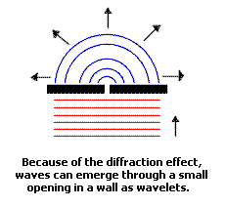
Diffraction
The bending of waves around the edge of an obstacle
This results in a new set of waves being formed

Slide 20
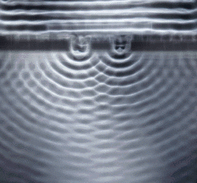
Diffraction in a ripple tank

Slide 21
Interference
2 waves meeting at the same point at the same time →a new wave is formed
Constructive interference: 2 crests combine, forming a single, larger wave(combine amplitudes)
Sum of waves 1 and 2
wave 1
wave 2

Slide 22
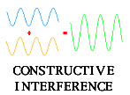
Constructive Interference

Slide 23
Interference
Destructive Interference: crest of one wave combines w/ trough of another(decreases amplitude)
Sum of waves 1 and 2
wave 2
wave 1

Slide 24
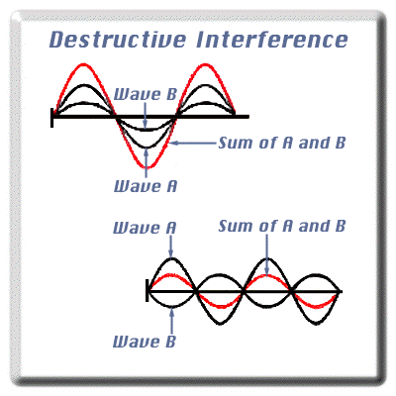
Destructive Interference
a

Slide 25
It’s Over

Slide 26
Wave Model of Sound
Sound waves are longitudinal
1. Motion of medium // to wave motion
2. Consists of compressions/rarefactions
Transmitting sounds(elasticity is key):
- move poorly through gases
- move okay through liquids
- move best through solids

Slide 27
Speed of Sound
Determined by 2 factors:
❶Temperature- higher the temp, faster the sound travels
❷Elasticity- more elastic the medium, faster the sound travels
Sound travels 340m/s in air(light travels 1,000,000x faster!!)
^{ex.} thunderstorm

Slide 28
Intensity
How much energy the wave has
Determined by amplitude(↑amp = ↑energy)
Determines the loudness of sound
Loudness measured in decibels(dB):
^{Ex.} Ticking of watch………………….. 20 dB
Normal conversation…………….. 60 dB
Shouting…………………………. 90 dB
Rock concert…………………….. 120 dB
Jet taking off…………………….. 150 dB
85 dB sustained will cause damage to ears
120 dB will cause immediate damage
soft
loud

Slide 29
Pitch
Pitch is how high or low a sound is
- depends how fast/slow molecules of a medium vibrate
Pitch = frequency(Hz)
Humans can hear pitches between 20Hz and 20,000 Hz.(>20,000Hz is ultrasonic)
Dogs, dolphins, and tortoises can hear ultrasonic pitches.
low note
high note

Slide 30
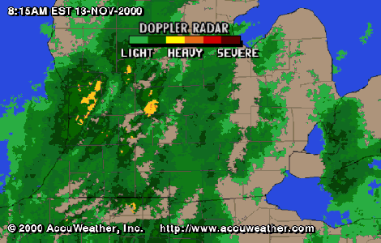
Doppler Effect
Is a change in frequency/pitch due to motion of sound or motion of observer of sound
As sound moves closer, frequency ⬆
As sound moves away, frequency ⬇

Slide 31
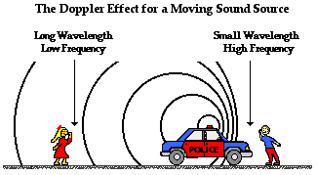
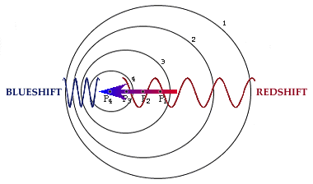
Doppler Effect

Slide 32
Wave Interaction in Sound
Resonance: ability of an object to absorb energy(of its own natural frequency) from another source.
^{ex.} Tuning in a radio, uses resonance to match the frequency of radio to the station
Constructive interference: waves combine and intensify sound
Destructive interference: waves cancel each other out, decreasing sound(^{ex.} dead spots in a hall with hard surfaces)
Acoustics: the science of sound

Slide 33
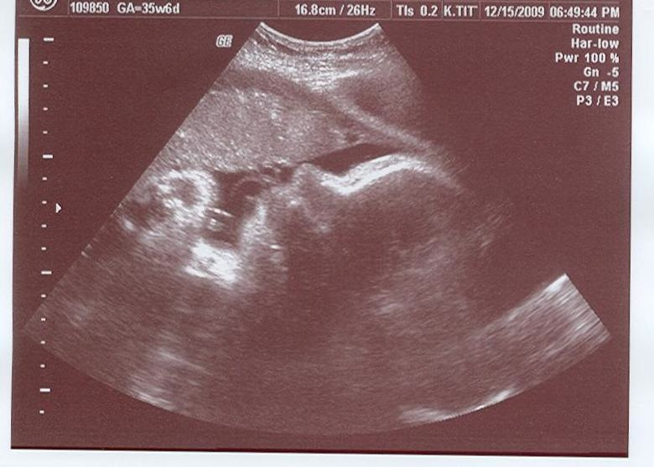
Sonar
Known as “sound navigation and ranging”
Measure of reflected sound waves (ultrasonic) bouncing off a solid object
Distance of object= (speed of sound waves) x (1/2 total time of travel)
^{Ex.} Ultrasound

Slide 34
Music........or noise????
Scientists define music as having…..
1. A pleasing quality(subjective!!)
2. A definite, identifiable pitch
3. A definite, repeating pattern(rhythm)
Horns, drums, strings vibrate to create sound
^{ex.} stringed instruments:
- shorter strings=⬆ frequency
- more tension = ⬆ frequency
-thinner strings =⬆ frequency

Slide 35
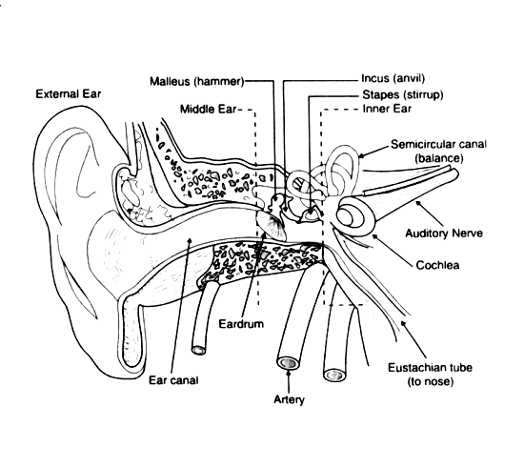
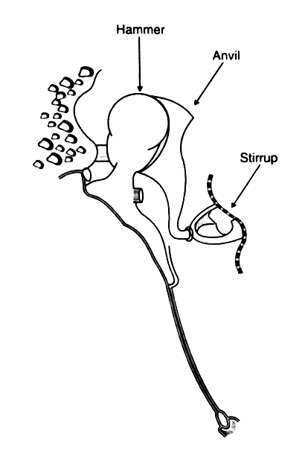

Slide 36
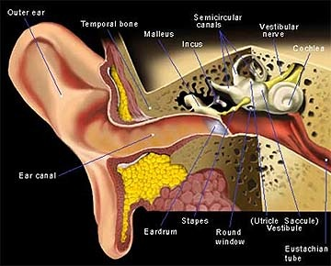

Slide 37
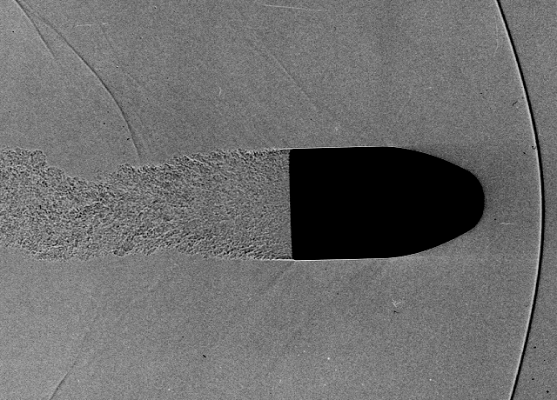
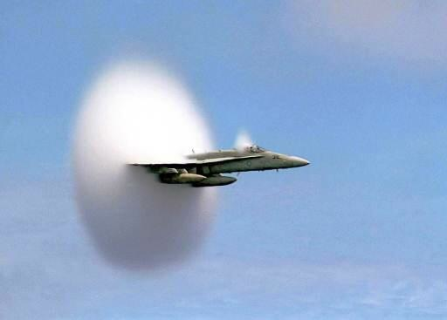
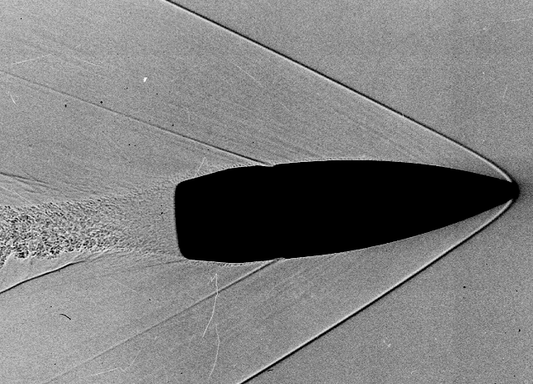
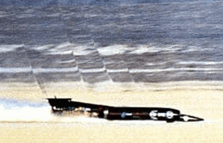
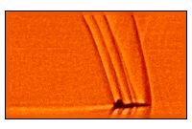
Faster than a Speeding Bullet….
Mach 1:
Watch this....
Mach 1.4
and beyond:
Listen to this....

Slide 38
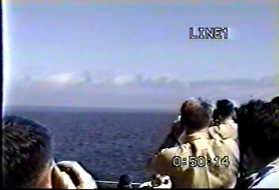

Slide 39
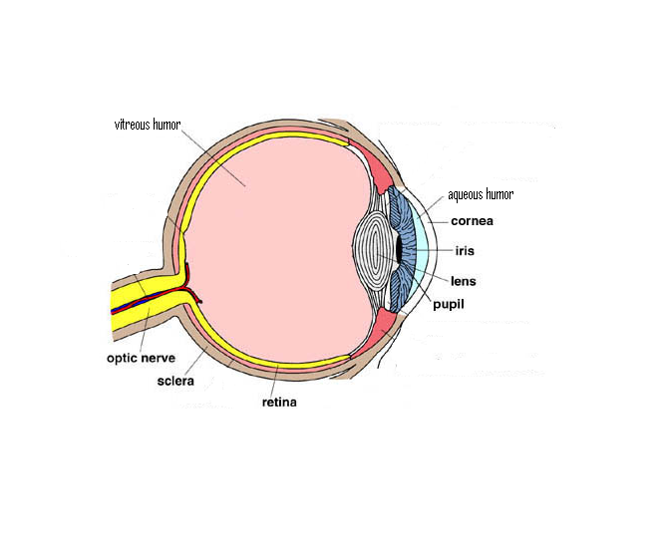

Slide 40
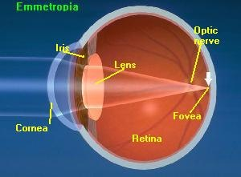
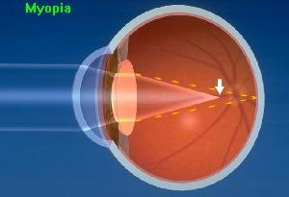
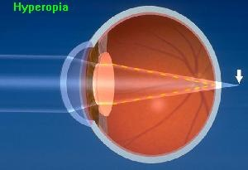
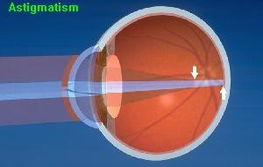
“Normal Eye”
Near-sighted
Far-sighted

Slide 42
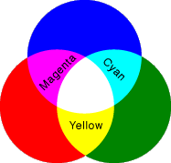
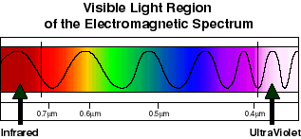
Visible Light

