Slide 1
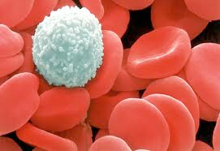
White Blood Cells
Immune System

Slide 2
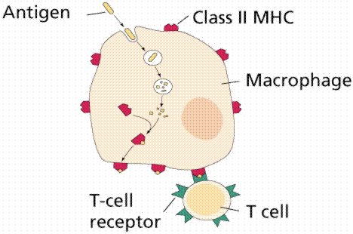
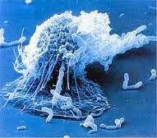
Macrophages
Surrounds and eats a virus
Small virus fragments are left on macrophage membrane
Acts as a “key” to activate T4 lymphocyte

Slide 3
T4 Lymphocyte
Receptor site “lock” for macrophage “key”
Produces interleukin-2 (chemical)

Slide 4
Interleuken-2
Starts the production of B-lymphocytes and T8 Lymphocytes

Slide 5
B-Lymphocyte
Grows and divides into
Plasma cells
Produce antiubodies against a virus
Antibodies (“Y” shaped) cover up landing gear on virus
Prevents infections
Memory cells
Strengthens immune system
Remains circulating in the blood
If virus enters body again → antibody production begins

Slide 6
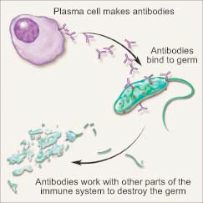

Slide 7
T8 Lymphocyte
Antibodies and Macrophages destroy the virus before it enters a cell
Interleukin-2 also produces T8 lymphocytes
T8 produces
Cytotoxic killer cells
Suppressor cells

Slide 8
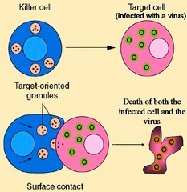
Cytotoxic Killer Cells
“cyto” = cell and “toxic” = poison
Destroys cells that have been infected with a virus

Slide 9
Suppressor Cells
Slows down the immune system
Tells T4 to stop producing Interleukin-2

Slide 10
HIV: Human Immunodeficiency Virus
Attacks T4
No Interleukin-2
No B lymphocytes (no antibodies)
No cytotoxic killer cells

